Slide 1
The Integrated Disclosures: Closing Disclosure
Presented by:
Coppelia Padgett
AffirmX & AdvisX
Senior Analyst

Slide 2
About Our Speaker
Coppelia Padgett, senior analyst at AffirmX, began her career as a Compliance Specialist for the FDIC working primarily out of Los Angeles. She left the FDIC to found the Triac Company in 1992. This consulting firm grew to serve the compliance needs of hundreds of financial institutions in the Los Angeles metropolitan area and around the United States.
In 2011, Ms. Padgett joined AffirmX (formerly known as Neighborbench) as a researcher, analyst, and writer.
She graduated magna cum laude from the University of Tulsa with a degree in Economics.

Slide 3
Outline for This Webinar:
The Basics of Implementation
The Closing Estimate Form- Page by Page
Page One- Loan Terms
Page Two- Closing Costs
Page Three- Summary Transactions & Cash to Close
Page Four- Disclosures & Escrow
Page Five- More Disclosures & Contact Info
Other Requirements
Trouble Shooting Questions

Slide 4
The Closing Disclosure

Slide 5
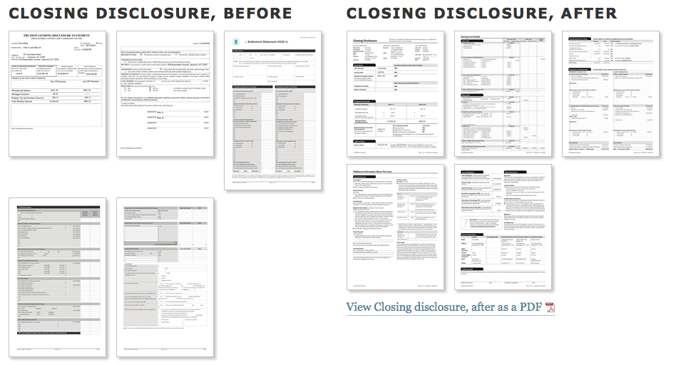
New Forms: Closing Disclosure
Notes:
THE CLOSING DISCLOSURE: The Closing Disclosure form replaces the current form used to close a loan, the HUD-1, which was designed by HUD under RESPA. It also replaces the revised Truth in Lending disclosure designed by the Board under TILA. The final rule and the Official Interpretations contain detailed instructions as to how each line on the Closing Disclosure form should be completed. The Closing Disclosure form contains additional new disclosures required by the Dodd-Frank Act and a detailed accounting of the settlement
transaction (. (There are actually 2 versions of this form: one for refinances and an a regular mortgage (it’s 5 to 8 pages long)) So much for eliminating paperwork.

Slide 6
Who Provides This Disclosure?
Creditors provide the Closing Disclosure form to consumers
Creditors may use settlement agents to provide the Closing Disclosure as long as the creditor ensures compliance
Notes:
settlement agents are required to provide the HUD-1 under RESPA, while creditors are required to provide the revised Truth in Lending disclosure under TILA. Now, both can preform this duty, but the Creditor is ultimately responsible.

Slide 7
Timing
The creditor must give the Loan Disclosure to consumers so that they receive it at least three business days before consummation of transaction.
Creditor must deliver or place the Loan Disclosure in the mail not later than 7 business days before consummation.
“Business day” HERE is all days but federal holidays and Sunday.
Notes:
Please note that this is NOT the definition used in the Loan Estimate. Business day before was any day the FI operated. Some institution are open on Sunday. Here Sunday is specifically excluded.

Slide 8
Consummation?
As defined in Regulation Z, the time that a consumer becomes contractually obligated on a credit transaction.
Not necessarily the same time as closing or settlement.
Can depend on state law.

Slide 9
General Requirements
Required for all loans with a Loan Estimate
Must generally contain the actual terms and costs of the transaction
Must be in writing based on form in appendix H-25
3 business days before consummation (3-day waiting period)
Prohibits lenders from charging fees for settlement services beyond those listed on the form with a few exceptions
Notes:
This is easier. If you gave out a Loan Estimate you need a Closing Disclosure to go with it.
The three business days before consummation is a significant change from the current law. This means just-in-time delivery of closing disclosures will no longer be acceptable. The consumer can waive 3 business day waiting period for a “bona fide” financial emergency.

Slide 10
Page 1: General Information
Mirrors the Loan Estimate
Lists the closing information, transaction information and loan information
Notes:
At the top of page 1 of the Closing Disclosure, disclose Closing Information, Transaction Information, and Loan Information. (§ 1026.38(a))
Closing Information
For Closing Information, disclose the following information:
Date Issued is the date the Closing Disclosure is delivered to the consumer,
The closing date,
The disbursement date,
The name of the Settlement Agent,
As File #, the settlement agent’s file number,
The Property address or location, an
For the property securing the loan:
Sale Price,
Appraised Prop. Value, or
Estimated Prop. Value. (§ 1026.38(a)(3))
The Appraised Prop. Value of the property securing the loan is disclosed for transactions without a seller. (§ 1026.38(a)(3)(vii)(B)) The Estimated Prop. Value of the property securing the loan is disclosed if the creditor has not obtained an appraisal for transactions without a seller. (comment 38(a)(3)(vii)-1)
Transaction Information
For Transaction Information, disclose the name of the consumer as Borrower, the name of the seller as Seller, and the name of the creditor as Lender. (§ 1026.38(a)(4))
The name and address of each consumer and seller in the transaction must be disclosed. If there is not enough space to show the name and address of all consumers and sellers in the transaction, an additional page may be used and appended to the end of the Closing Disclosure. (comment 38(a)(4)-1)
Loan Information
For Loan Information, disclose the Loan Term, Purpose, Product, Loan Type, the creditor’s loan identification number as Loan ID #, and mortgage insurance case number, if required by the creditor, as MIC # under the Loan Information subheading. (§ 1026.38(a)(5))
The information disclosed for Loan Term, Purpose, Product, Loan Type, and Loan ID # are determined by the same definitions for those items on the Loan Estimate. These items should be updated to reflect the terms of the legal obligation at consummation. (comment 38(a)(5)-1)

Slide 11
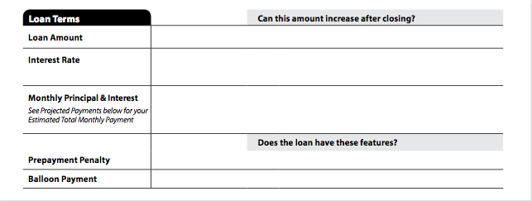
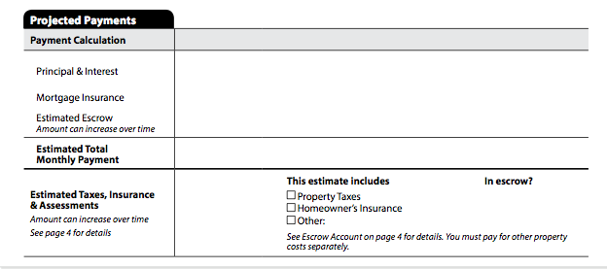
Page 1: Loan Terms & Projected Payments
Notes:
Loan Terms
The Loan Terms table on the Closing Disclosure discloses the same information required to be disclosed on the Loan Estimate (see section 2.2.2 above), updated Monthly Payment to reflect the terms of the legal obligation at consummation. (§ 1026.38(b))
Projected Payments
The Projected Payments table on the Closing Disclosure discloses the same information required to be disclosed on the projected payments table disclosed on the loan estimate, updated to reflect the terms of the legal obligation at consummation.

Slide 12
Page 1: Costs at Closing
Notes:
Costs at Closing
The Costs at Closing table discloses:
The total amount disclosed as Total Closing Costs in the Other Costs table disclosed on page 2 of the Closing Disclosure. Total Closing Costs are also itemized to show the Total Loan Costs, the Total Other Costs, and Lender Credits from the Total Closing Costs subheading disclosed on page 2 of the Closing Disclosure and
The estimated amount of cash the consumer will pay at, or receive from, closing Mortgage Insurance as Cash to Close. This amount is the same as the Cash to Close calculated in the Calculating Cash to Close table on page 3 of the Closing Disclosure.
(§ 1026.37(d)(1)(ii))
Alternative Costs at Closing
Disclose the Alternative Costs at Closing table for transactions without a seller where the Alternative Estimated Costs at Closing table was disclosed on the Loan Estimate. (see section 2.2.4 above; § 1026.38(d)(2)) check boxes are used in order to indicate whether the amount of cash is due from or paid to the consumer at consummation. (comment 38(d)(2)-2) If the Alternative Costs at Closing table is used, then the Alternative Calculating Cash to Close on page 3 of the Closing Disclosure must also be used. (comment 38(d)(2)-1)

Slide 13
Or the Alternative Costs at Closing if no Seller
Notes:
Alternative Costs at Closing
Disclose the Alternative Costs at Closing table for transactions without a seller where the Alternative Estimated Costs at Closing table was disclosed on the Loan Estimate. (see section 2.2.4 above; § 1026.38(d)(2)) check boxes are used in order to indicate whether the amount of cash is due from or paid to the consumer at consummation. (comment 38(d)(2)-2) If the Alternative Costs at Closing table is used, then the Alternative Calculating Cash to Close on page 3 of the Closing Disclosure must also be used. (comment 38(d)(2)-1)

Slide 14
Closing Cost Details
If cost changes occur between the time the form is given and closing, a new form must be issued and an additional 3 days to review the form must be permitted (see page two).
Notes:
Page 2 of the Closing disclosure is a detailed accounting of the settlement transaction comparing what was estimate and actual costs. Similar to the loan estimate things are dived into loan costs and other costs.
The number of items in the Loan Costs and Other Costs tables can be expanded and deleted to ensure that the Loan Costs and Other Costs tables fit onto page 2 of the Closing Disclosure. (§ 1026.38(t)(5)(iv)(A)) However, items that are required to be disclosed, even if they are not needed (such as Points in the Origination Charges subheading), cannot be deleted. (Comment 38(t)(5)(iv)-1)
The amounts paid by the consumer, seller and others for each item are disclosed. For items paid by the consumer or seller, the amount that is paid at or before closing is also entered into the applicable columns. (§ 1026.38(f)) To the extent that an individual item is paid by different parties to the transaction and both at and before closing, the amounts associated with an item can be entered in multiple columns. (§ 1026.38(f))
The Loan Costs and Other Costs tables can be disclosed on two separate pages of the Closing Disclosure. (§ 1026.38(t)(5)(iv)(B)) When used, these pages are numbered page 2a and 2b. (Comment 38(t)(5)(iv)-3) For an example of this permissible change to the Closing Disclosure, see form H-25(H) of appendix H to Regulation Z.

Slide 15
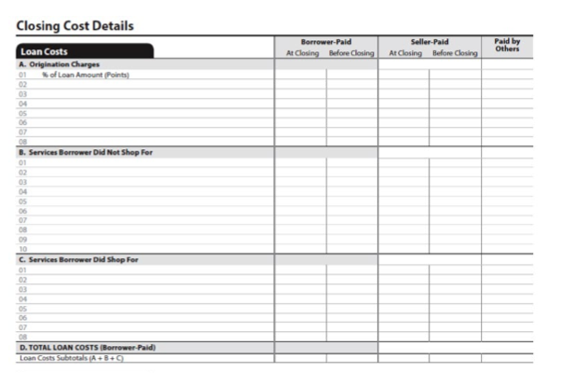
Page 2: Loan Costs
Notes:
The items to be disclosed in the Loan Costs table should generally be the same as they were disclosed on the Loan Estimate (see section 2.3.1 above), updated to reflect the terms of the legal obligation at consummation, except as specifically discussed below. (§ 1026.38(f))
Origination Charges - Loan Originator Compensation
Loan originator compensation is disclosed as Origination Charges, even though loan originator compensation is not disclosed on the Loan Estimate. compensation from the consumer to a third-party loan originator is designated as Borrower-Paid At Closing or Before Closing on the Closing Disclosure.
Compensation from the creditor to a third-party loan originator is designated as Paid by Others on the Closing Disclosure. (comment 38(f)(1)-2) A designation of (L) can be listed with the amount to indicate that the creditor pays the compensation at consummation. The amount of compensation from the creditor to the third-party loan originator is the same as the amount of third-party compensation included in points and fees for purposes of determining the consumer’s ability to pay the loan. (comment 38(f)(1)-3) compensation to individual loan originators is not calculated or disclosed on the Closing Disclosure. (comment 38(f)(1)-3)
Services the Consumer Did and Did Not Shop For
Items that the consumer could have shopped for, but did not, are disclosed in the Services Borrower Did Not Shop For subheading, regardless of where the item was disclosed on the Loan Estimate. (§ 1026.38(f)(2))
When a consumer chooses a provider that was on the Written List of Providers for a service, that service is listed as Services Borrower Did Not Shop For in the Closing Disclosure Loan Costs table. (§ 1026.38(f)(2); comment 38(f)(3)-1) Items disclosed as Services Borrower Did Shop For and Services Borrower Did Not Shop For are re-alphabetized when an item is added to or removed from the Closing Disclosure, when compared to the Loan Estimate.
Total Loan Costs
The amounts that are designated as Borrower-Paid At or Before Closing are subtotaled as Total Loan Costs (Borrower-Paid). (§ 1026.38(f)(5)) The amounts that are designated Seller-Paid At or Before Closing and Paid by Others are not subtotaled as Total Loan Costs (Borrower-Paid). (comment 38(f)(5)-1)

Slide 16
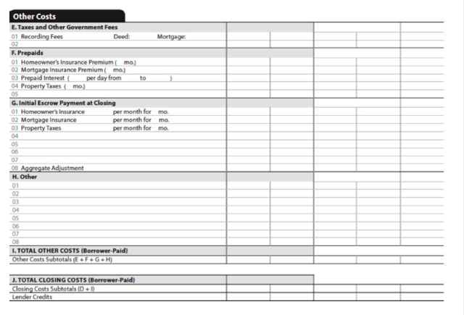
Page 2: Other Costs
Notes:
The items to be disclosed in the Other Costs table should be disclosed as they would be disclosed on the Loan Estimate (see section 2.3.2 above), updated to reflect the terms of the legal obligation and real estate transaction at consummation, except as specifically discussed below. (§ 1026.38(g))
Taxes and Other Government Fees
An itemization of Transfer Taxes paid by the consumer and the seller is disclosed under the heading Taxes and Other Government Fees, instead of the sum total of Transfer Taxes to be paid by the consumer. (§ 1026.38(g)(1))
Prepaids
Prepaids are items to be paid by the consumer in advance of the first scheduled payment of the loan. (§ 1026.38(g)(2)) Prepaids are:
Homeowner’s Insurance Premium,
Mortgage Insurance Premium,
Prepaid Interest,
Property Taxes, and
A maximum of three additional items.
Each item must include the applicable time period covered by the amount to be paid by the consumer and the total amount to be paid.
Initial Escrow Payment at Closing
Property Taxes paid during different time periods can be disclosed as separate items. (§ 1026.38(g)(3)) For example, general property taxes assessed for January 1 to December 31 and property taxes to fund schools for November 1 to October 31 can be disclosed as separate items. (comment 38(g)(3)-3)
The last item disclosed in the Initial Escrow Payment at closing is the Aggregate Adjustment. (§ 1026.38(g)(3)) The Aggregate Adjustment is calculated under Regulation X. (§ 1024.17(d)(2); comment 38(g)(3)-2)
Other
Items are disclosed as Other to reflect costs incurred by the consumer or seller that were not required to be disclosed on the Loan Estimate. (§ 1026.38(g)(4); comment 38(g)(4)-1) These costs include:
Real estate brokerage fees,
Homeowner or condominium association fees paid at consummation,
Home warranties,
Inspection fees, and
Other fees paid at closing that are not required by the creditor or otherwise required to be disclosed elsewhere on the Closing Disclosure.
The amount of an earnest money deposit does not affect the amount of real estate commissions paid by the consumer or seller on the Closing Disclosure, even if the earnest money deposit is held by the real estate brokerage. (comment 38(g)(4)-1 and -4)
Total Other Costs and Total Closing Costs
The total of all closing costs paid by the consumer, reduced by the Lender Credit, is disclosed as Total Closing Costs (Borrower-Paid). (§ 1026.38(h)(1)) The total of items designated as Borrower-Paid At or Before Closing, Seller-Paid At or Before Closing, and Paid by Others are disclosed as Closing Cost Subtotals.
(§ 1026. 38(h)(2)) Lastly, the total amount of Lender Credits, if any, are disclosed and designated as Borrower-Paid At Closing. (§ 1026.38(h)(3))

Slide 17
Lender Credits
Must disclose regardless of reason or source
If credit is tied to a charge listed on Page 2, then the amount should be listed with the item and designated Paid by Others.
Notes:
Lender Credits (in exchange for a slightly higher interest rate, in some cases the lender will offer a lender credit to offset some of the lender or third party fees)
All general lender credits, regardless of their reason or source, are included as Lender Credits. (comment 38(h)(3)-1) however, if the lender credit is attributable to a charge listed on Closing Disclosure page 2, then the amount should be listed with the item and designated as Paid By Others. (comment 38(h)(3)-1) A designation of (L) can be listed with the amount to indicate that the creditor pays the item at consummation.
The creditor should include the amount of any offset to resolve an excess charge by the creditor as Lender Credits. (§ 1026.38(h)(3)) A statement that such an amount is paid by the creditor to offset an excess charge, with funds other than closing funds, is also included as part of Lender Credits. (comment 38(h)(3)-2; see form h-25(F) of appendix h to Regulation Z for an example of this statement)

Slide 18
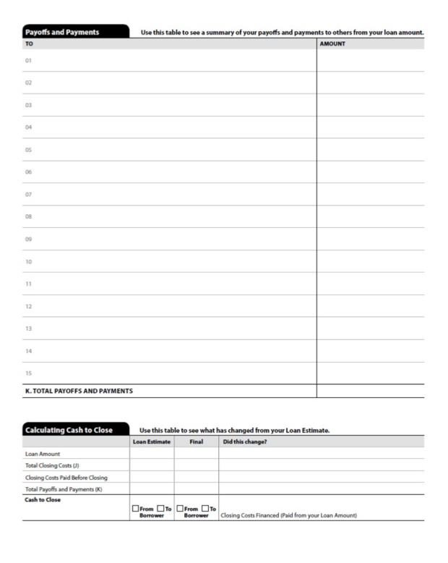
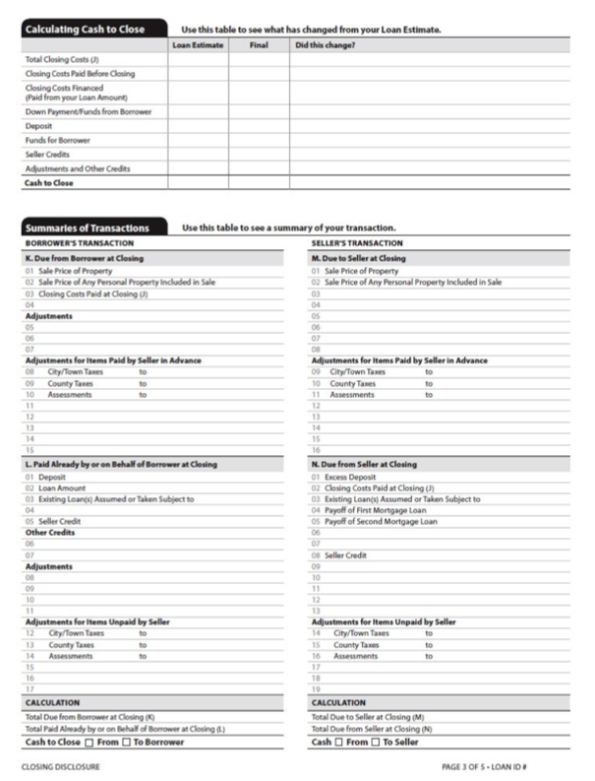
Page 3: Cash to Close & Summaries of Transaction
This is where the Calculating Cash to Close table and Summaries of Transaction table are disclosed. For transactions without a seller, a Payoffs and Payments table may be substituted for the Summaries of Transactions table and placed before the Alternative Calculating Cash to Close table.
.
Notes:
There are three columns here. The change is highlighted so consumers will notice
On page 3 of the Closing Disclosure, the Calculating Cash to Close table and Summaries of Transaction table are disclosed. For transactions without a seller, a Payoffs and Payments table may be substituted for the Summaries of Transactions table and placed before the Alternative Calculating Cash to Close table. (See Figure 40; form H-25(J) of appendix H to Regulation Z)
First picture is the standard and the second is the alternative disclosures for no seller. Second one is clearly easier.

Slide 19
Page 3: Calculating Cash to Close (Top of Page 3)
.
Breakdown of closing costs and then provides a side-by-side comparison to the loan estimate and a third column to note any change.
Consumers WILL notice any change and you will must be prepared to explain.
Notes:
The Calculating Cash to Close table has nine items listed in the table:
Total closing costs,
Closing costs Paid Before closing,
Closing costs Financed (Paid from your Loan Amount),
Down Payment/Funds from Borrower, § deposit,
Funds for Borrower,
Seller credits,
Adjustments and other credits, and
Cash to close.
The table has three columns to disclose the amount for each item as it was disclosed on the Loan Estimate (see section 2.3.3 above), the Final amount for the item, and an answer to the question Did this change? (§ 1026.38(i))
Generally, the amount disclosed in the Loan Estimate column is the same as the amount disclosed on the Loan Estimate or a revised Loan Estimate. The amounts disclosed in the Loan Estimate column are rounded to the nearest dollar in order to match the corresponding amount disclosed on the Loan Estimate’s Calculating Cash to Close table. (comment 38(i)-2)
The amounts in the Final column are calculated using the same methods that were used for the Calculating Cash to Close table on the Loan Estimate, except that the amounts used to determine the amounts are the amounts disclosed on the Closing Disclosure or determined at consummation. (comment 38(i)-2)
When the answer to the question Did this change? is Yes, indicate where the consumer can find the amounts that have changed on the Loan Estimate. For example, if the Seller Credit amount changed, the creditor can indicate that the consumer should “See Seller credits in Section L.” (comment 38(i)-3) other examples of language for these items are found in example form h-25(B) in appendix h of Regulation Z.
Total Closing Costs
In the Final column, Total Closing Costs is the same amount as the amount disclosed as Total Closing Costs (Borrower-Paid) on page 2 of the Closing Disclosure. (see section 3.2.4 above; § 1026.38(i)(1)(ii)) When the amount in the Final column is different from the amount in the Loan Estimate column, indicate that the consumer should see the Total Loan Costs or Total Other Costs tables, as applicable, on page 2 of the Closing Disclosure. (§ 1026.38(i)(1)(iii)(A)(2))
Increases in Total Closing Costs That Exceed the Legal Limits
When the increase in Total closing costs exceeds the legal limits, disclose a statement that an increase in closing costs exceeds the legal limits by the dollar amount of the excess in the Did this change? column. (§ 1026.38(i)(1)(iii)(A)(3)) A statement directing the consumer to the Lender Credit on page 2 must also be included if a credit to the consumer at closing for the excess amount is provided by the creditor. (comment 38(i)(1)(iii)(A)-3)
Closing Costs Paid Before Closing
The amount disclosed in the Loan Estimate column for the Closing Costs Paid Before Closing item is $0. (§ 1026.38(i)(2)(i)) The Final column should disclose the same amount designated as Borrower-Paid Before Closing in the Closing Costs Subtotals of the Other Costs table on page 2 of the Closing Disclosure.

Slide 20
Page 3: Alternative Calculating Cash to Close Table for Transaction Without a Seller
.
Breakdown of closing costs and then provides a side-by-side comparison to the loan estimate and a third column to note any change.
Consumers WILL notice any change and you will must be prepared to explain.
Notes:
Disclose an Alternative Calculating Cash to Close table for transactions without a seller when the Alternative Calculating Cash to Close table was used on the Loan Estimate.
The Alternative Calculating Cash to Close table has five items listed in the table:
Loan Amount,
Total closing costs,
Closing costs Paid Before closing,
Total Payoffs and Payments, and
Cash to close.
The table has three columns to disclose the amount for each item as it was disclosed on the Loan Estimate, the Final amount for the item, and an answer to the question Did this change? (§ 1026.38(e))
In addition, disclose Closing Costs Financed (Paid from your Loan Amount) in the third column of the Final item. (§ 1026.38(e)(6))
Except as discussed below, the amount disclosed in the Loan Estimate column is the same as the amount disclosed on the Loan Estimate or a revised Loan Estimate. (§ 1026.38(e)(1)(i), (2)(i), (4)(i),(5)(i)) The amounts disclosed in the Loan Estimate column are rounded to the nearest dollar in order to match the corresponding amount disclosed on the Loan Estimate’s Calculating Cash to Close table. (comment 38(e)-3)
Loan Amount
Loan Amount should have the same amount disclosed, as a positive number, in the Final column as the Loan Amount in the Loan Terms table on page 1 of the Closing Disclosure. (§ 1026.38(e)(1)(ii))
Total Closing Costs
Total Closing Costs should have the same amount disclosed in the Final column as the amount disclosed as Total Closing Costs (Borrower-Paid) on page 2, as a negative number. (§ 1026.38(e)(2)(ii)) When the amount in the Final column is different from the amount in the Loan Estimate column, the creditor should indicate that the consumer should see the Total Loan Costs or Total Other Costs subheadings, as applicable, on page 2 of the Closing Disclosure. (§ 1026.38(e)(2)(iii)(A)(2))

Slide 21
Page 3: Alternative Calculating Cash to Close Table for Transaction Without a Seller
.
Notes:
Increase in Total Closing Costs That Exceed The Legal Limit
When the increase in Total closing costs exceeds the legal limits, disclose a statement that an increase in closing costs exceeds the legal limits by the dollar amount of the excess in the Did this change? column. (§ 1026.38(i)(1)(iii)(A)(3)) A statement directing the consumer to the Lender Credit on Closing Disclosure page 2 must also be included if a credit to the consumer at closing for the excess amount is provided by the creditor. (comment 38(i)(1)(iii)(A)-3)
Closing Costs Paid Before Closing
For Closing Costs Paid Before Closing, disclose $0 in the Loan Estimate column. (§ 1026.38(e)(3)(i)) The Final column should disclose the same amount designated as Borrower-Paid Before Closing in the Closing Costs Subtotals
of the Other Costs table on Closing Disclosure page 2, as a positive number. (§ 1026.38(e)(3)(ii))
Total Payoffs and Payments
Total Payoffs and Payments, should have the same amount in the Final column as the amount disclosed as Total Payoffs and Payments from the Payoffs and Payments table on page 3, as a negative number. (§ 1026.38(e)(4)(ii))
Cash to Close
Cash to Close discloses the sum of Loan Amount, Total Closing Costs, Closing Costs Paid Before Closing, and Total Payoffs and Payments in the Loan Estimate and Final columns, with indications of whether the totals are due to or from the consumer. (§ 1026.38(e)(5)(ii))
Closing Costs Financed (Paid from your Loan Amount)
Closing Costs Financed (Paid from your Loan Amount) is the sum of the amounts in the Final column of the Loan Amount and Total Payoffs and Payments. however, the amount is disclosed only if the sum is greater than zero and no larger than the Total Closing Costs (deducting the amount in the Final column of Closing Costs Paid Before Closing). (§ 1026.38(e)(6))

Slide 22
Page 3: Summary of Transaction Table
Notes:
Use the Summaries of Transactions table to disclose the amounts associated with the real estate purchase transaction between the consumer and seller, together with closing costs, in order to disclose the amounts due from or payable to the consumer and seller at closing, as applicable. (§ 1026.38(j),(k)) A separate Closing Disclosure can be provided to the consumer and the seller that do not reflect the other party’s costs and credits by omitting certain disclosures on each separate Closing Disclosure. (§ 1026.38(t)(5)(v),(vi),(ix))
In transactions without a seller, the creditor does not provide the Seller’s Transaction column as part of the Closing Disclosure. (comment 38(k)-1) A creditor can also decide to replace the Summaries of Transactions table with a Payoffs and Payments table (see Figure 40) when the Alternative Cash to Close and Alternative Calculating Cash to Close tables are used. (§ 1026.38(t)(5)(vii))
Generally, the Summaries of Transactions table is similar to the Summary of Borrower’s Transaction and Summary of Seller’s Transaction tables on the hud-1 Settlement Statement provided under Regulation X prior to the TILA-RESPA rule taking effect. There are some modifications to the Closing Disclosure related to the handling of the disclosure of the consumer’s Deposit, the disclosure of Credits, and other matters, discussed below.

Slide 23
Page 3: Borrower’s Transaction
Notes:
A creditor can work with a Settlement Agent, and the Settlement Agent can disclose the Borrower’s Transaction column of the Summaries of Transactions table. Any references to the creditor would apply to the settlement agent when the Settlement Agent discloses the Borrower’s Transaction column. (§ 1026.19(f)(1)(v))
Due From Borrower at Closing
The amount Due from Borrower at Closing is the sum of:
Sale Price of Property,
Sale Price of Any Personal Property Included in Sale,
Closing costs Paid at closing,
Other consumer charges,
Adjustments, and
Adjustments for Items Paid by the Seller in Advance, pursuant to the terms of the real estate sale contract. (§ 1026.38(j)(1))
Personal Property is defined by State law, but could include such items as carpets, drapes, and appliances. Manufactured homes are not considered personal property for the Closing Disclosure. (comment 38(j)(1)(ii)-1)
Closing Costs Paid at Closing is the amount designated as Borrower-Paid At Closing on page 2 of the Closing Disclosure. (§ 1026.38(j)(1)(iv))
disclose other consumer charges owed by the consumer in the real estate closing not otherwise disclosed on page 2 of the Closing Disclosure as Due from Borrower at Closing.
Examples include:
Amounts paid to any existing holders of liens on the property in a refinance transaction, and
Any outstanding real estate property taxes.
These amounts are disclosed without a corresponding credit in the Seller’s Transaction column. (comment 38(j)(1)(v)-2)
Adjustments due from the consumer to be paid to the seller are disclosed in two
places.
First, amounts owed by the consumer that are neither disclosed on Closing Disclosure page 2 nor specifically required to be disclosed as Due from Borrower at Closing. Examples of these amounts include:
A balance in a seller’s reserve account transferred to the consumer in connection with an assumed loan,
Rent that the consumer will collect after closing for a period of time prior to the closing, and
The treatment of any tenant security deposit. (comment 38(j)(1)(v)-1) §
Second, additional adjustments are disclosed along with the time-period associated with the adjustment. Examples include:
Taxes paid in advance for an entire year when the closing occurs prior to the expiration of the year,
Flood or hazard insurance premiums when the consumer is being substituted as an insured under the same policy,
Mortgage insurance in connection with an assumed loan,
Planned unit development or condominium association assessments paid in advance,
Fuel or other supplies on hand purchased by the seller which the consumer will use when the consumer takes possession of the property, and
Ground rent paid in advance by the seller. (comment 38(j)(1)(x)-1)
Paid Already By or on Behalf of Borrower at Closing
The amount Paid Already by or on Behalf of Borrower at Closing is the sum of: § deposit,
Loan Amount,
Existing Loan(s) Assumed or Taken Subject to,
Seller credits,
Other credits, and
Adjustments for Items unpaid by Seller pursuant to the terms of the real estate sale contract. (§ 1026.38(j)(2))
Deposit is the amount paid into a trust account by the consumer pursuant to a contract of sale. (comment 38(j)(2)(ii)-1) If the Deposit has been applied toward a closing cost paid by the consumer, the amount so applied should be deducted from the amount of the Deposit. (comment 38(j)(2)(ii)-2) no deduction in the amount of the Deposit is to be made for the payment of any real estate commission disclosed on page 2 of the Closing Disclosure. (comment 38(g)(4)-4)
Existing Loan(s) Assumed is the total amount of all loans that the consumer is assuming in the transaction, even if more than one loan is being assumed. (comment 38(j)(2)(iv)-1)
Seller Credits include any general credit to the consumer from the seller and includes a seller making an allowance to the consumer for items to purchase separately. (§ 1026.38(j)(2)(v)) however, if the seller’s agreement is attributable to a charge listed on Closing Disclosure page 2, then the amount should be listed with the item and designated as Seller-Paid at Closing or Seller-Paid Before Closing on Closing Disclosure page 2. (comment 38(j)(2)(v)-1)
Seller Credits include any seller credits for issues identified at a walk-through of the Property. (comment 38(j)(2)(v)-2)
Other Credits include a general credit from any party other than the seller or creditor. (§ 1026.38(j)(2)(vi)) one example is a credit a consumer receives from a
real estate agent. A description of the credit and the name of the party giving the credit must also be included. however, if the credit or rebate is attributable to a charge listed on page 2 of the Closing Disclosure, then the amount should be listed with the item and designated as Paid by Others on Closing Disclosure page 2. (comment 38(j)(2)(vi)-1)
Other Credits include any transferred escrow balance in a refinance transaction. (comment 38(j)(2)(vi)-4) Other Credits also include a credit for any money or other payments made by family members associated with the transaction, along with a description of the nature of the funds. (comment 38(j)(2)(vi)-5)
disclosure of any amount paid with funds other than closing funds by a consumer in connection with a subordinate loan payoff are disclosed with a statement that such amounts were paid with outside of closing funds. (comment 38(j)(2)(vi)-3)
Adjustments for Items Unpaid by Seller are amounts due to the consumer to be paid by the seller and are disclosed in two places.
First, items are disclosed along with the time-period associated with the item. Examples include:
Taxes paid in arrears for an entire year when the closing occurs prior the start of the year,
Flood or hazard insurance premiums when the consumer is being substituted as an insured under the same policy,
Mortgage insurance in connection with an assumed loan,
Planned unit development or condominium assessments not yet paid, and
Ground rent not yet paid by the seller. (§ 1026.38(j)(2)(vii), (viii), (ix), (x))
Second, additional amounts owed by the seller that are not disclosed on page 2 or specifically included as Due from Seller at Closing. Examples of these amounts include:
Utilities used but not paid for by the seller,
Rent collected in advance by the seller for a period extending beyond the closing date, and
Interest on loan assumptions. (comment 38(j)(2)(xi)-1)
Cash to Close To or From Borrower
Under a subheading of Calculation:
Disclose Total due from the Borrower at closing as a positive number.
Disclose Total Paid Already by or on Behalf of the Borrower at closing as a negative number. (§ 1026.38(j)(3))
Disclose the sum of Total due from the Borrower at closing and Total Paid Already by or on Behalf of the Borrower at closing. disclose the sum as cash to close From Borrower when the sum is a positive number, and disclose the sum as cash to close To Borrower when the result is a negative number. The sum is disclosed as a positive number in either event. (comment 38(j)(3)(iii)-2)

Slide 24
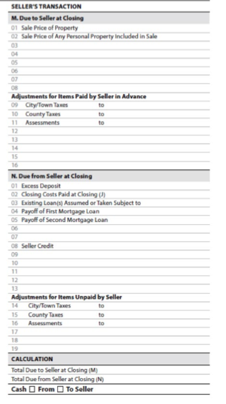
Page 3: Seller’s Transactions
Notes:
The Settlement Agent completes and discloses the Seller’s Transaction column of
the Summaries of Transactions table. (§ 1026.19(f)(4))
Due to Seller at Closing
Disclose the amount Due to Seller at Closing as the sum of: § The Sale Price of the Property,
Sale Price of Any Personal Property Included in Sale,
Adjustments, and
Adjustments for Items Paid by Seller in Advance due to the seller pursuant to the terms of the real estate sales contract. (§ 1026.38(k)(1))
Personal Property is defined by state law, but could include such items as carpets, drapes, and appliances. Manufactured homes are not considered personal property for the Closing Disclosure. (comment 38(j)(1)(ii)-1)
Adjustments due from the consumer to be paid to the seller are disclosed in two categories:
First, amounts owed by the consumer that are neither disclosed on page 2 nor specifically required to be disclosed as Due from Borrower at Closing. Examples of these amounts include:
A balance in a seller’s reserve account transferred to the consumer in connection with an assumed loan,
Rent that the consumer will collect after closing for a period of time prior to the closing, and
The treatment of any tenant security deposit. (comment 38(j)(1)(v)-1)
Second, Adjustments for Items Paid by Seller in Advance are disclosed along with the time-period associated with the adjustment. Examples include:
Taxes paid in advance for an entire year when the closing occurs prior the expiration of the year,
Flood or hazard insurance premiums when the consumer is being substituted as an insured under the same policy,
Mortgage insurance in connection with an assumed loan,
Planned unit development or condominium association assessments paid in advance,
Fuel or other supplies on hand purchased by the seller which the consumer will use when the consumer takes possession of the property, and
Ground rent paid in advance by the seller. (comment 38(j)(1)(x)-1)
Due from Seller at Closing
Disclose the amount Due from Seller at Closing as the sum of:
Any Excess deposit,
Closing costs Paid at closing by the Seller,
Existing Loan(s) Assumed or Taken Subject to by the consumer, § Payoff of First Mortgage Loan,
Payoff of Second Mortgage Loan,
Payment of other seller obligations,
Seller credit,
Adjustments, and
Adjustments for Items unpaid by Seller due to the consumer pursuant to the terms of the real estate sale contract. (§ 1026.38(k)(2))
Excess Deposit is the amount of any deposit made by the consumer that has been disbursed to the seller prior to closing. (comment 38(k)(2)(ii)-1)
Seller Credit is an amount the seller is giving as a general credit not tied to a specific charge on page 2 or is making as an allowance to the consumer for items to purchase separately. (§ 1026.38(k)(2)(vii)) The amount of Seller Credit would include any credits to the consumer as the result of a walk-through of the property prior to the closing. (comment 38(k)(2)(iv)-2) however, if the amount of a credit is attributable to a charge listed on page 2, then the amount should be listed with the applicable item on page 2 and designated as Seller-Paid At Closing or Seller- Paid Before Closing, as appropriate. (comment 38(j)(2)(v)-1)
Disclose the Payoff of the First Mortgage Loan, if any, (§ 1026.38(k)(2)(v)) and then the Payoff of the Second Mortgage Loan, if any. (§ 1026.38(k)(2)(vi)) disclose the payoff or satisfaction amounts for any additional seller obligations as separately itemized amounts. (§ 1026.38(k)(2)(viii)) Examples of these seller obligations include, but are not limited to:
Satisfaction of outstanding liens imposed due to Federal, State or local income taxes,
Real estate property tax liens,
Judgments against the seller reduced to a lien upon the property,
Other obligations the seller wishes the Settlement Agent to pay from the seller’s proceeds at closing, and (comment 38(k)(2)(viii)-1)
Funds to be held by the Settlement Agent for repairs or the payment of water, fuel, or other utility bills that cannot be prorated between the parties at closing because the amounts used by the seller prior to closing are not yet known at closing. Subsequent disclosure of a revised Closing Disclosure after the repairs are made or the utility bill is received is optional. (comment 38(k)(2)(viii)-3)
Disclose any amount paid with funds other than closing funds in connection with a subordinate loan payoff with a statement that such amounts were paid from outside of closing funds. (comment 38(k)(2)(viii)-2)
Adjustments for Items Unpaid by Seller due to the consumer to be paid by the seller pursuant to the real estate sales contract has two components:
First, disclose amounts owed by the seller with the time period associated with the adjustments. Examples include:
Taxes paid in arrears for an entire year when the closing occurs prior the start of the year,
Flood or hazard insurance premiums when the consumer is being substituted as an assured under the same policy,
Mortgage insurance in connection with an assumed loan,
Planned unit development or condominium assessments not yet paid, and
Ground rent not yet paid by the seller. (§ 1026.38(k)(2)(ix), (x), (xi), (xii))
Second, disclose amounts owed by the seller that are neither disclosed on page 2 nor specifically disclosed as Due from Seller at Closing. (§ 1026.38(k)(2)(xiii)) Examples of these amounts include:
Utilities used but not paid for by the seller,
Rent collected in advance by the seller from a tenant for a period of extending beyond the closing date, and
Interest on loan assumptions. (comment 38(j)(2)(xi)-1)
Cash to Close Due to or From Seller
Under a subheading of calculation:
Disclose Total due to the Seller at closing, as a positive number.
Disclose Total due from Seller at closing, as a negative number. (§ 1026.38(k)(3))
Disclose the sum of Total due to the Seller at closing and Total due from Seller at closing as a positive number. When the result is a positive number, disclose the amount as cash to Seller. When the result is a negative number, disclose the amount as cash from Seller. The sum is disclosed as a positive number in either event. (comment 38(k)(3)-2)

Slide 25
Page 4: Additional Information
Notes:
This page is primarily educational. It has the loan disclosures about Assumptions, demand features, late payments, negative amortization, partial payments- all check boxes– all yes or no primarily. Then you have adjustable payment APR table and Adjustable Interest rate AIR table again trying to instill the notion that these loan can and will change.
There is much more information about escrow than on the old forms. CFPB believes that novice consumers don’t understand escrow. So the closing disclosure discloses whether the loan will have an escrow account and must disclose certain details as to payments. It also has standardized warnings to consumers that escrow payments may change and warnings about failure to pay property taxes or costs.

Slide 26
Page 4: Loan Disclosures
Notes:
In the Loan Disclosures table, disclose:
Information concerning future Assumption of the loan by a subsequent purchaser
Whether the legal obligation contains a Demand Feature that can require early payment of the loan,
The terms of the legal obligation that impose a fee for a Late Payment including the amount of time that passes before a fee is imposed and the amount of such fee or how it is calculated,
Whether the regular periodic payments can cause the principal balance of the loan to increase, creating Negative Amortization,
The creditor’s policy in relation to Partial Payments by the consumer,
A statement that the consumer is granting a Security Interest in the Property (along with an identification of the Property), and
Information related to any Escrow Account held by the servicer (or a statement that an Escrow Account has not been established with a description of estimated property costs during the first year after consummation). (§ 1026.38(l)(1)-(7))

Slide 27
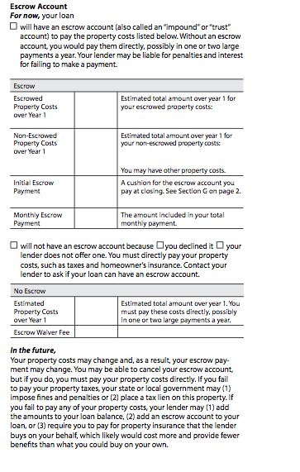
Page 4: Escrow Account
Notes:
When an Escrow Account is established, disclose:
The amount of Escrowed Property Costs over Year 1 with a list of the costs that will be paid by the Escrow Account,
The amount of Non-Escrowed Property Costs over Year 1 with a list of the costs that will not be paid by the Escrow Account (to the extent there is room to list the costs in the space provided),
Initial Escrow Payment
Monthly Escrow Payment
When an Escrow Account is not established, disclose:
The amount of Estimated Property Costs over year 1, and
The amount of any Escrow Waiver Fee imposed for waiving the creation of an Escrow Account with the loan.
Property Costs include:
Property Taxes,
Homeowner’s Insurance,
Charges imposed by a cooperative, condominium or homeowners association,
Ground rent
Leasehold payments, and
Certain insurance premiums or charges if required by the lender
The Initial Escrow Payment is the same amount disclosed as the subtotal of the Initial Payment at Closing on page 2 of the Closing Disclosure.

Slide 28
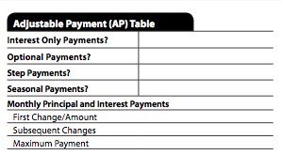
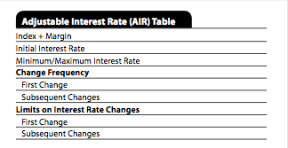
Page 4: Adjustable Payment (AP) Table & Adjustable Interest Rate (AIR) Table
Notes:
Adjustable Payment (AP) Table
Disclose the Adjustable Payment (AP) Table when the periodic principal and interest payment may change after consummation, but not because of a change to the interest rate, or the loan is a seasonal payment product. (§ 1026.38(m)) If the loan does not contain these features, do not disclose the AP Table. The same information that was or would have been disclosed in the AP Table on the Loan Estimate is disclosed in the AP Table on Closing Disclosure page 4, updated to reflect the terms of the loan at consummation.
Adjustable Interest Rate (AIR) Table
Disclose the Adjustable Interest Rate (AIR) Table when the loan’s interest rate may increase after consummation. (§ 1026.38(n)) If the loan’s interest rate will not increase after consummation, do not disclose the AIR Table. (comment 38(n)-3) The same information that was or would have been disclosed in the AIR Table on the Loan Estimate is disclosed in the AIR Table on Closing Disclosure page 4, updated to reflect the terms of the loan at consummation. (Comment 38(n)-4)

Slide 29
Page 5: Loan calculations, Disclosures & Contact Info
There are new additional disclosures as required by Dodd-Frank Act.
Notes:
This page explains how key terms are calculated like finance charge, APR etc. More disclosures about appraisals, refinance tax deductions. Then there is the contact information again including the SAFE act MLO numbers. Then there is an optional confirm receipt signature. Like the loan estimate this is not required.
Neither the Finance Charge or the APR calculation changed in the final rule. The changes in the proposed rule would have been very problematic.
Disclose:
Loan Calculations
Other Disclosures
Questions
Contact Information
Confirm Receipts

Slide 30
Page 5: Loan Calculations & Other Disclosures
Notes:
Loan Calculations
Disclose the Total of Payments, the Finance Charge, the Amount Financed, the APR, and the Total Interest Percentage (TIP) in the Loan Calculations table. The APR and TIP amounts should be updated from the amounts disclosed on the Loan Estimate to reflect the terms of the legal obligation at consummation.
Other Disclosures
The creditor discloses in the other disclosures table:
A statement related to the consumer’s rights in relation to any Appraisal conducted for the property,
A statement informing the consumer of consequences of nonpayment, what constitutes default, when a creditor can accelerate maturity, and prepayment rebates and penalties pursuant to contract details
A statement of whether State law provides for continued consumer responsibility for any Liability after Foreclosure,
A statement concerning the consumer’s ability to Refinance the loan, and
A statement concerning the extent that interest on the loan can be included as a Tax Deduction by the consumer.
Appraisal
Loan Calculations Other Disclosures
A statement concerning the Appraisal must be provide for:
Higher-priced Mortgage Loans,
Loans covered by the Equal Credit opportunity Act
If the loan is Higher-priced Mortgage Loan, but not covered by the Equal Credit Opportunity Act, the word “promptly” may be removed from the language provided on the model form.

Slide 31
Page 5: Contact Information & Confirm Receipt
Notes:
Contact Information
In the Contact Information table, disclose the following information for the Lender, the Mortgage Broker, the consumer’s Real Estate Brokerage, the seller’s Real Estate Brokerage, and the Settlement Agent in a columnar format:
Name,
Address,
The NMLS or State license Id, as applicable,
The contact name of an individual (and the NMLS or State license Id),
Email, and
Phone number.
Unused columns may be removed and columns may be added for additional parties. For Example:
If there are two real estate brokers representing the seller, a column may be added to identify that party and a column for a party not involved in the transaction may be deleted.
Confirm Receipt
The creditor, at its option, may include a line for the signatures of the consumers to Confirm Receipt. If the creditor includes a signature line to Confirm Receipt, the creditor must also include a statement that the signature only signifies receipt of the Closing Disclosure. (§§ 1026.38(s), 1026.37(n)(1))
If the creditor does not include statement line or the consumer’s signature, add a statement to the Other Disclosures concerning Loan Acceptance that states: “You do not have to accept this loan because you have received this form or signed a loan application.” (§§ 1026.38(s)(2), 1026.37(n)(2))

Slide 32
Trouble Shooting:
What if a consumer asks for the revised Closing Disclosure before consummation?
What if there is more than one consumer?
Disclosure must be given separately to each consumer who has the right of rescission.
In non-rescindable transaction, only the primary liability consumer needs the disclosure.
Can a consumer waive the 3-business day waiting period?
Yes, under certain circumstances. (written statement-no forms)

Slide 33
Revisions & Corrections
General rule: Creditors must re-disclose terms or costs on Closing Disclosure if certain changes occur to the transaction, making it inaccurate
3 types of changes
Changes before consummation requiring new 3-business day waiting period
Change before consummation not requiring new waiting period
Changes occurring after consummation

Slide 34
New Forms & Waiting Period Required
Disclosed APR becomes inaccurate above a certain threshold
Changes in loan product
Adding a prepayment penalty
Notes:
above 1/8 of a % for most loans (1/4 of a percent for irregular payment loans)

Slide 35
New Forms & NO Waiting Period Required
Changes that do not affect the following:
APR
Loan product
Adding a prepayment penalty
Notes:
above 1/8 of a % for most loans (1/4 of a percent for irregular payment loans)

Slide 36
Tolerance Violations
General rule: If consumer paid more than disclosed on Loan Estimate beyond applicable tolerance.
Creditor must refund the excess within 60 days
Provide a Corrected Closing Disclosure reflecting refund within 60 days
Notes:
I was surprised by the delay. I thought we would have this requirement in January, but there must be some sort of problem either in switching over in technology or problem on the examiner side.

Slide 37
10% Cumulative Tolerance:
If the total sum of charges exceeds the sum disclosed by more than 10%, the difference must be refunded to the consumer.
Corrected Closing Disclosures would be needed.
Notes:
Just a reminder

Slide 38
Changes after Consummation
You need a corrected disclosure:
When an event with settlement has made the disclosure inaccurate and results in a change to the amount paid by the consumer or seller within 30 days of consummation
To document refunds for tolerance violations
To correct non-numerical clerical errors (errors that don’t effect numbers or timing or other requirements)

Slide 39
Record Retention
Closing Disclosure (& related documents) for 5 years after consummation
Post-Consummation Escrow Closing (cancelation) Notice for 2 years.
Post-Consumation Partial Payment Disclosure for 2 years.
All Other Evidence of Compliance (Loan Estimate form) for 3 years after consummantion.

Slide 40
What if you Sell the Loan?
If a creditor sells, transfers or otherwise disposes of its interest in a mortgage and is not the servicer, then the creditor provides a copy of the Closing Disclosure to the new owner/servicer.
Both the creditor and the new owner/servicer retain the Closing Disclosure for the remainder of the 5 year period.

Slide 41
How?
The proposal for electronic recordkeeping was dropped from the new rule.
Records may be maintained by any method as long as the disclosures can be reproduced accurately.

Slide 42
Don’t Forget!
Special Information Booklet — no later than 3 days after receiving the application
Escrow Account Cancellation Notice
Partial Payment Disclosure Notice
Right to an Appraisal Notice

Slide 43
Change Is Inevitable
Don’t panic!
Work with your IT department, forms providers and other key service providers
Identify and train your relevant staff
Adjust as you get feedback from your staff, consumers & regulators
YOU CAN DO THIS!

Slide 44
OUTSOURCING TO THIRD PARTIES
Bonus Topic

Slide 45
What is 3rd Party Outsourcing?
Use of an external service provider
Lending (indirect, leasing, mortgage origination/servicing, subprime lending, MBLs)
Marketing
Human Resources
IT
Compliance

Slide 46
With Regard to Integrated Disclosures
Outsourcing Form/ Form Generation (Loanliner)
Outsourcing Preparing & Providing the Forms
Brokers
Settlement Agents

Slide 47
Why Outsource?
To gain operational and financial efficiencies
Obtain specialized expertise
Increase management focus on core business functions
Refocus limited internal resources on core functions
Increase availability of products and services

Slide 48
Why Outsource?
Accelerate delivery of products/ services through new delivery channels
Increase ability to acquire and support current technology & avoid obsolescence
Conserve capital for other business ventures

Slide 49
Why Outsource?
Improve the quality of products and services
Strengthen controls
Help manage costs
Whatever the reason(s), the decision to outsource should compliment your overall strategic plan and corporate objectives

Slide 50
Important to Remember
You may outsource the generation, preparation or delivery of these forms, but Management and the Board still remain ultimately responsible for managing the associated risks.

Slide 51
What Are the Risks?
With Forms Generation
The Major Companies have Guarantees written into their Contracts
Liability is ONLY for errors in the Forms themselves or in Calculations with are part of the Forms/System
NO Guarantees for “User Error” (Garbage In/Garbage Out= You are Responsible)

Slide 52
What Are the Risks?
With Brokers or Settlement Agents
Time Period Requirements Not being Met
Wrong Understanding of 3 Days
Forms will be Filled Out Incorrectly
Not providing accurate fee and cost information
Not describing loan terms appropriately
Estimates that are Significantly off from the Closing Disclosure

Slide 53
Evaluating the Risks
The Greatest Probability of Significant Errors will be in the first few Months.
August to December 2015
More Unusual the Situation = the Greater Likelihood of Errors

Slide 54
Board/ Management Responsibility
Understand the risks associated with the item/function being outsourced
Ensure that effective risk management strategies and practices are in place
Conduct a risk assessment and determine if the risk level is acceptable

Slide 55
Board/ Management Responsibility
Require clearly written and sufficiently detailed contracts that provide assurances for performance, reliability, security, confidentiality and reporting
Implement an oversight program to monitor each service provider’s operations, financial conditions and performance standards

Slide 56
Engaging a 3rd Party Service Provider
Planning Stage
Reasonable rational for outsourcing
Cost/benefit analysis
Costs of monitoring and providing support to the 3rd party
Contingency plan if 3rd party fails to perform
Fully identify the scope and nature of the function to be outsourced

Slide 57
Engaging a 3rd Party Service Provider
Planning
Identify standards and service levels
Identify the minimum acceptable service provider characteristics
Establish your monitoring and reporting requirements
Identify transition requirements
Identify key contractual provisions

Slide 58
Engaging a 3rd Party Service Provider
Perform Due Diligence
Corporate history
Qualifications, backgrounds, reputations of the principals (include criminal checks when appropriate)
Check user references
Review audited financial statements

Slide 59
Engaging a 3rd Party Service Provider
Perform Due Diligence
Look at service delivery capability, status, and effectiveness
Look at the internal controls environment
Review their security history, audit coverage
Determine if there have been any legal actions, consumer or user complaints, regulatory actions

Slide 60
Engaging a 3rd Party Service Provider
Contract Negotiation
Verify the accuracy of the description of the outsourcing relationship
Each party’s rights and responsibilities should be clearly written with sufficient detail
Involve legal counsel, when appropriate

Slide 61
Engaging a 3rd Party Service Provider
Third Party Service Provider Contracts
Performance standards
Security and confidentiality
Positive statement
Prohibition against 3rd party using or disclosing information except as necessary
Compliance with applicable laws and regulations
Full and prompt disclosure of any breaches that may materially affect the CU or its members and the corrective actions they have taken

Slide 62
Engaging a 3rd Party Service Provider
Third Party Service Provider Contracts
Establish controls
Internal controls
Record maintenance requirements
CU access to the records
Notification requirements and approval rights for changes to services, key project personnel, service locations, etc.)

Slide 63
Engaging a 3rd Party Service Provider
Third Party Service Provider Contracts
Audit Requirements
Types of audit to be performed with copy to the CU
Right to obtain documentation on resolution of any deficiencies and/or to inspect facilities

Slide 64
Engaging a 3rd Party Service Provider
Third Party Service Provider Contracts
Termination Requirements
Timeliness, flexibility and cost to terminate the risk
Notification requirements
Timely return of CU data, records, etc.
Assignment
Regulatory Compliance

Slide 65
Policies and Procedures
Be sure to revise Credit Union policies and procedures to appropriately address the new outsourcing relationship

Slide 66
Ongoing Monitoring
Ensure that 3rd party service providers are subject to the same risk management, security, privacy and other policies that would be expected if the Credit Union was conducting the activities in-house.

Slide 67
Ongoing Monitoring
Ensure that the CU has sufficient expertise to oversee and manage the relationship
Amount of time and resources devoted to managing the relationship should be based on the risk the relationship presents to the CU

Slide 68
What Will Your Regulator Look For?
Did the CU exercise due diligence in the selection of the 3rd party provider?
Does the CU understand its rights and responsibilities under the contract? (Legal opinion)
Do the CU’s policies address the outsourced relationship?
Does the CU had adequate measures to determine that Disclosures are being handled properly?

Slide 69
Conclusion
Third Party Outsourcing can allow a Credit Union to offer enhanced service without the various expenses involved in owning the required technology or in maintaining the human capital required to operate the service and can offer a cost effective alternative to in-house capabilities

Slide 70
Q&A, anyone?
Notes:
Well we have covered a lot of material today. I thank you for your attention. If you have any questions, there are two ways to ask a question. You can type a question in the question box on your screen. Also you can ask a live question, by clicking on the fourth icon down on the left side of your gotowebinar control panel. I will unmute you and introduce you by your first name only.

Slide 71
Q&A Discussion
Coppelia Padgett
Senior Analyst
coppelia.padgett@affirmX.com
888.972.3624 ext.7013
www.riskinbox.com
Stop by daily for what’s hot right now in compliance & risk for credit unions & banks

