Slide 1
The Integrated Disclosures: Loan Estimate Details!
Presented by:
Coppelia Padgett
AffirmX & AdvisX
Senior Analyst

Slide 2
About Our Speaker
Coppelia Padgett, senior analyst at AffirmX, began her career as a Compliance Specialist for the FDIC working primarily out of Los Angeles. She left the FDIC to found the Triac Company in 1992. This consulting firm grew to serve the compliance needs of hundreds of financial institutions in the Los Angeles metropolitan area and around the United States.
In 2011, Ms. Padgett joined AffirmX (formerly known as Neighborbench) as a researcher, analyst, and writer.
She graduated magna cum laude from the University of Tulsa with a degree in Economics.

Slide 3
This Lecture
This Lecture is Brutal
The Subject Matter is Hard to Work With in a lecture format
Very detailed
Numbers and Fine Print
Limited Source Material – Official Commentary and that’s about it
The approach must be different
Notes:
I am leading people through forms– basically I’m reading the form instructions for hours. Brutally Boring. And difficult to absorb. Listening to numbers is hard. It was hard to follow slides, because to fit the pages on the slides you have to make them small– its ok on a computer screen but really hard to see from a distance.

Slide 4
How this is Going to Work
Go Over Handouts First
You Will Follow Along With Me Using the One of the Handouts
Write Your Notes
We will Stop After Every Page to Discuss Issues rather than at the End
Much More Interactive Group Study than a Lecture

Slide 5
Pros & Cons
It Should be less BORNING
It Should be More Useful
It Will REQUIRE More Participation on Your Part

Slide 6
Outline for This Webinar:
Your Handouts
General Observations on The Combined Disclosures
The Loan Estimate Form
Page One/ Group Work
Page Two/ Group Work
Page Three/ Group Work
Notes:
We Will Stop after Each Page for a Mini Quiz and do Group Work

Slide 7
The Handouts

Slide 8
Handout # 1
Notes:
This annotated form is intended to provide a starting point for analysis of the relevant regulatory text. For complete and definitive requirements, please refer to the rule and its Official Interpretations. This annotated form does not represent legal interpretation, guidance, or advice of the Bureau. This document does not bind the Bureau and does not create any rights, benefits, or defenses, substantive or procedural, which are enforceable by any party in any manner.

Slide 9
The Combined Disclosures

Slide 10
Why Integrated Mortgage Disclosures?
Both regulations (RESPA & TILA) covered mortgage loans, have consumer disclosures with similar information and timing, and serve the same general purpose.
Burden for lenders
Confusion for consumers
Competition between two different agencies (HUD & FRB)
Duplication of efforts

Slide 11
CFPB Takes Over
Uses the “Know Before You Owe” philosophy
CFPB took 18 months to create new forms
Interactive comment process
Testing of prototypes forms
Public outreach
Small business panel

Slide 12
Highlights of the New Forms
New Forms
New timing requirements for disclosures (1026.19(e) and (f))
New tolerance levels for disclosed estimates (1026.19(e) and (f))
New pre-disclosure requirements (1026.19(e)(2))

Slide 13
When Is All This Final?
Integrated Mortgage Disclosures Under RESPA (X) & TILA (Z) have been delayed 3 times. Now the effective date is August 1, 2015.
Notes:
As of November 20 when the Final Rule came out this section of the regulation (the combined disclosures) were delayed another full year and a half. This is the second delay original deadline July 21, 2012 then . The first year long delay was to wait till the rest of the Mortgage Servicing Rules were ready for implementation. But then delayed again to assist forms providers. Creditors will still be required to use the GFE, HUD-1, and Truth-in-Lending forms for applications received prior to August 1, 2015. As the applications received prior to August 1, 2015 are consummated, withdrawn, or cancelled, the use of the GFE, HUD-1, and Truth-in Lending forms will no longer be used for most mortgage loans.

Slide 14
Can You Use these Forms Prior to 8/1/15?
NO. The old forms must be used for all applications received prior to August 1, 2015.
The old law is in effect until that date.
Notes:
The law is set like an on/off switch. Aug 1st the switch happens. You cannot by law use the new forms till that date even if you are ready. Consequently, August will be hard because you will be processing two types of forms.

Slide 15
Who Is Covered?
TILA/RESPA integrated mortgage disclosures apply to most closed-end mortgages regardless of FI asset size or pricing of mortgages
NO SMALL CREDITOR EXEMPTION UNDER THIS RULE.
Higher priced mortgages are covered (with other additional HPM rules)
Notes:
This would include purchases, refinances, closed end home equity loans, This includes both first lien and subordinate liens.
NO SMALL CREDITOR EXEMPTION UNDER THIS RULE. AND HIGHER PRICED MORTGAGES ARE APPLIABLE WITH OTHER RULES. The higher priced mortgages have other rules other disclosures but they are IN ADDITION TO NOT INSTEAD OF INTEGRATED DISCLOSURES.

Slide 16
What Does This NOT Apply To?
Does NOT apply to home-equity lines of credit, reverse mortgages, or mortgages secured by a mobile home or by a dwelling that is not attached to land.
Does NOT apply to Commercial/Business loans
Does NOT apply if you make five or fewer mortgages a year or are not a “creditor” under regulation Z.
Notes:
These loan products will continue to be covered by the existing regulatory requirements– at least for now. That means that what ever forms you were using to make reverse mortgages, or HELOCs you will STILL use them. You CANNOT use the integrated mortgage disclosures for these products. The CFPB has indicated that it “plans to address integrated disclosures requirements” for these loans. So there could be a day in the future were the integrated mortgage disclosures could be required for HELOCs or reverse mortgage, but not today.

Slide 17
Fine Print Warning
Certain types of loans currently subject to TILA and NOT RESPA are covered by integrated disclosures
Construction-Only Loans
Loans secured by vacant land or by 25 or more acres
Notes:
These two types of loans were not covered by RESPA but have been placed under the integrated disclosures . Tricky here. Because they aren’t typically thought of as consumer mortgage loans. This was an amendment added in 2014 to expand the coverage. Don’t forget about it.

Slide 18
Record Retention
Closing Disclosure (& related documents) for 5 years after consummation
Post-Consummation Escrow Closing (cancelation) Notice for 2 years.
Post-Consummation Partial Payment Disclosure for 2 years.
All Other Evidence of Compliance (Loan Estimate form) for 3 years after consummation.

Slide 19
What if you Sell the Loan?
If a creditor sells, transfers or otherwise disposes of its interest in a mortgage and is not the servicer, then the creditor provides a copy of the Closing Disclosure to the new owner/servicer.
Both the creditor and the new owner/servicer retain the Closing Disclosure for the remainder of the 5 year period.

Slide 20
Key Resources
CFPB TILA-RESPA Integrated Disclosure Guide
CFPB/Federal Reserve Webinar June 2014
NAFCU Compliance Blog
CFPB Integrated Disclosure Rule implementation Resource Page (Forms & Samples)

Slide 21
The Loan Estimate Form

Slide 22
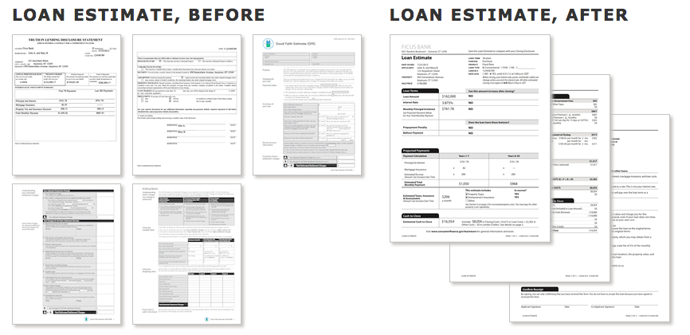
The New Form: Loan Estimate
Notes:
The Loan Estimate form replaces two current federal forms. It replaces the Good Faith Estimate designed by the Department of Housing and Urban Development (HUD) under RESPA and the “early” Truth-in-Lending disclosure designed by the Board of Governors of the Federal Reserve System (Board) under TILA. The final rule and the Official Interpretations contain detailed instructions as to how each line on the Loan Estimate form should be completed. There are sample forms for different types of loan Products

Slide 23
Purpose of the Loan Estimate
CFPB wants consumers to use forms as they evaluate different loans.
Interest rate, monthly payments, & closing costs are on first page
More information on costs of taxes, insurance and how the interest rate & payments may change in the future
Less flexibility for the bank or credit union
More time for the consumer (3 days)

Slide 24
General Requirements
Contain a “good faith estimate” of credit costs & transaction terms
Must be in writing & contain information in 1026.37
Within 3 days of application (in person or mail)
Creditors must use the standard Loan Estimate form (form H-24) – (But electronic, machine-readable form was dropped from the final rule)
Must be provide at least 7 days before the closing disclosure (just as current rule)
Notes:
The requirement that the early disclosure be provided at least 7 days before the closing disclosure remains unchanged just like our current forms. There is still a provision that allows consumers to waive the seven day waiting period only for a bona fide personal financial emergency (written wavier, dated, and not on a form) We will discuss that more later.
This means customers will have to wait even if they are ready. Mortgage cannot be processed faster than 7 days without a real emergency.

Slide 25
What is an Application?
Neither TILA or RESPA define “application” in the statue
An application can be written or electronic and can include a written record of an oral application.
The old Regulation X had a definition consisting of 5 elements or pieces of information.
The new rule is similar with 6 elements
Notes:
The laws do not define application– The CFPB does. Definition of an Application is “Mostly” the same (new regulation has 6 pieces of info rather than 5)(page 1 top) (name, income, social security # for the credit report, property address, estimate of property value and amount sought.) The estimate of property value is the new one I think. There used to be a catch-all “any other info the lender deemed necessary” and this is gone. The CFPB will tell you what information you need.

Slide 26
When Is It an Application?
“Application” means you have received enough information to start the process. It includes:
Consumer’s name
Consumer’s income
Social Security number (credit report)
Property address
Estimate of value of property
Amount sought
Notes:
Property is the address of the property (which must include the zip code) that will secure the transaction. Not talking Mailing Address here. If the address of the Property is unavailable, use a description of the location of the property, for example a lot number. Always use a zip code. (Comment 37(a)(6)-1) Personal property such as furniture or appliances that also secures the credit transaction may be, but is not required to be included as Property. An additional page may not be appended to the Loan Estimate to disclose a description of personal property
Estimated Value of the Property: If the loan is for a purchase money mortgage, use Sale Price. (§ 1026.37(a)(7)(i)) If personal property is included in the Sale Price of the Property, use that price without any reduction for the appraised or estimated value of the personal property. (Comment 37(a)(7)-2) If the loan is for a transaction without a seller, use Appraised Value or Estimated Value. (

Slide 27
What if you still need more information?
You are not prevented from collecting whatever additional information deemed necessary.
Just when you have these six pieces of information, you have an application for purposes the Loan Estimate
Then the three-business-day timing requirement begins.
Notes:
This definition of application does not prevent a creditor from collecting whatever additional information it deems necessary in connection with the request for the extension of credit.
However, once a creditor has received the six pieces of information discussed above, it has an application for purposes of the requirement for delivery of the Loan Estimate to the consumer, including the three-business-day timing requirement. (Comment 2(a)(3) -1)

Slide 28
Revised Loan Estimate
When there is a changed circumstances after the Loan Estimate has been provided, the creditor can revise the Loan Estimate within 3 Business Days
The Revised Loan Estimate generally can be provided NO LATER than 7 Business days before consummation.
Notes:
We will talk about this in more detail later.

Slide 29
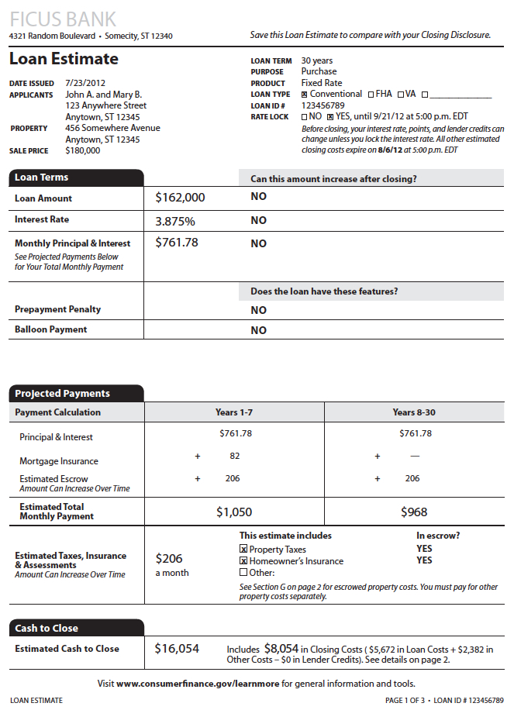
Loan Estimate: Timing
Must be GIVEN within 3 business days of receiving application.
In Person
Electronically (E-Sign Rules)
Placed in the Mail
“Mailbox Rule”
Notes:
Loan estimate form must be) Given Means directly or in the mail or electronically provided within 3 days of application. The Mailbox rule If mailed it is considered received with in 3 days of mailing it. The assumption is that the post office can get anybody their letter in 3 business days. Might be shorter in reality, but the assumption is 3 days.

Slide 30
What is a Business Day?
For the Loan Estimate, a business day is a day on which the creditor’s officers are open to the public for carrying out substantially all of its business functions. (Comment 19(e)(i)(iii)-1; 1026.2(a)(6)
For the Closing Disclosure and any revised Loan Estimate, a business day is defined differently. All calendar days except Sundays and the legal public holidays 1026.2(a)(6); Comment 2(a)(6)-2; Comment19(f)(1)(ii)-1
Notes:
The law is not internally consistent with two different definitions of business day. I don’t know why they would do this. We see different definitions between laws frequently but very seldom within the same law.
Note that the term business day is defined differently for other purposes; including counting days to ensure the consumer receives the Closing Disclosure on time. (See
§§ 1026.2(a)(6), 1026.19(f)(1)(ii)(A) and (f)(1)(iii)). For these other purposes, business day means all calendar days except Sundays and the legal public holidays specified in 5 U.S.C. 6103(a), such as New Year’s Day, the Birthday of Martin Luther King, Jr., Washington’s Birthday, Memorial Day, Independence Day, Labor Day, Columbus Day, Veterans Day, Thanksgiving Day, and Christmas Day.

Slide 31
Will this be a Problem?
Possible Timing Differences
Confusion for your Staff
Confusion for Examiners
CFPB appears to be aware of the issue and has released some timing guidance
TILA/ RESPA Integration disclosure timeline example
Notes:
If your institution is not open Sunday, this won’t affect you at all. But if you are open Saturday, Sunday timing issues could arise.
This handout will be emailed to you after the webinar with other tools and aids. It has several different examples of how you determine when things are do.

Slide 32
In Your Handouts

Slide 33
What If the Consumer Withdraws?
If the consumer withdraws within the three-day period, then the creditor does not have to provide the Loan Disclosure.
Similarly, if the creditor cannot approve on the terms requested by the consumer, the creditor does not have to provide a Loan Disclosure.
Similarly, if the consumer amends the application, then the creditor must provide the Loan Disclosure within the 3 days of receiving the amended application.
Notes:
For example, consumer wants a 100% LTV loan and you don’t make those types of loans. No Loan Disclosure needed.

Slide 34
Rounding Dollar Amounts
Always To the Nearest Whole Dollar
Percentage Amounts May Not be Rounded
Dealing with Sums
If the amounts are NOT required or permitted to be rounded, use the unrounded amounts and round the sum
If the amounts used are rounded, use the rounded amounts and do not round the sum
Notes:
Dollar amounts must be rounded to the nearest whole dollar where noted in the regulation. (1026.37(o)(4). If an amount is required to be rounded but is composed of other amounts that are NOT required or permitted to be rounded, use the unrounded amounts in calculating the total and then round the final sum. Conversely, if an amount is required to be rounded and is composed of rounded amounts, use the rounded amounts in calculating the total. Percentage amounts may not be rounded and should b e shown up to two or three decimals, as needed, except where noted in the regulation. If a percentage amount is a whole number, show the whole number only with no decimals.
Percentage amounts may not be rounded and should be shown up to two or three decimals, as needed, except where noted in the regulation. (§ 1026.37(o)(4)(ii)) If a percentage amount is a whole number, show the whole number only with no decimals. (§ 1026.37(o)(4)(ii); Comment 37(o)(4)(ii)-1)

Slide 35
Estimates on the Estimate
What if some information is unknown at the time the Loan Estimate is Made?
If not reasonably available, the creditor may use estimates. But must label them as such.
However, new disclosures may be required as a result. (Comment 17©(2)(i)-1)

Slide 36
Completing the Loan Estimate
Page 1: General Information
Application info: property, loan, and rate lock status
Loan terms
Projected payments during the term of the loan
Costs at closing including the total estimated closing costs and the estimated cash to close
Notes:
This is the general info on the first page

Slide 37
Completing the Loan Estimate
GENERAL INFORMATION
Warning: Product could cause issues!
Notes:
Your Name is on the top. If there are multiple creditors, use only the name of the creditor completing the Loan Estimate. A logo or slogan can be used as long as it does not exceed the space provided.
DATE Issued is the date mailed or delivered to the consumer – IMPORTANT that’s what examiners check.
Applicants includes the name and mailing address of the consumer(s) applying for the loan. Use each Applicant’s name and mailing address if there are multiple Applicants. An additional page may be added to the Loan Estimate if the space provided is insufficient to list all of the Applicants.
Property is the address of the Property securing the Transaction-not billing address and MUST include the ZIP Code.
Sales Price if it’s a purchase money loan then it really is the sales price, if personal property is included still use the sales price without deduction, if there is no seller use appraised or estimated value. Comment 37 a 71 talks about how that is calculated.
Loan Term is the term of the debt obligation. Describe the Loan Term as “years” when the Loan Term is in whole years. For example “1 year” or “30 years.”(Comment 37(a)(8)-1.i, -1.ii) For a Loan Term that is more than 24 months but is not whole years, describe using years and months with the abbreviations “yr.” and “mo.,” respectively. For example, a loan term of 185 months is disclosed as “15 yr., 5mo.” For a Loan Term that is less than 24 months and not whole years, use months only with the abbreviation “mo.” For example, “6 mo.” or “16 mo.”
Purpose: consumers intended use for the loans 4 options: purchase, refinance, construction or Home Equity Loan (is the catch all any other purpose)
The next one is Product and we are going to look at that closely on the next slide.

Slide 38
Product Detail
PRODUCT:
Features that change the periodic payment & its Duration
Negative Amortization
Interest Only
Step Payment
Balloon Payment
Seasonal Payment
Information on the Product Rate
Adjustable Rate
Step Rate
Fixed Rate
Adjustable Rate (if rate may increase after consummation, but the rates or periods they apply ARE NOT know)
Example 5/3 Adjustable Rate
No intro period 0/1 Adjustable Rate
Step Rate (if rate may increase after consummation, but the rates or periods they apply ARE know)
Example: 10/1 Step Rate
No intro rate 0/1 Step Rate
Fixed Rate (not the other two)
For time periods 24 months or more disclose the applicable fraction of a year by use of decimals to two places. (2.58/1 Adjustable Rate)
For time periods 24 months or less, disclose the number of months with the abbreviation “mo.” (18 mo./18 mo. Adjustable Rate)
Notes:
Product: 2 Pieces of info here. Any payment feature that may change the periodic payment and the duration of the relevant payment feature. Such as….
Seasonal Payment is when the terms of the legal obligation expressly provide that regular periodic payments are not scheduled between specified unit periods
on a regular basis. For example, a “teacher” loan that does not require monthly payments during summer months has a Seasonal Payment.
§§ If the loan can be described with more than one of these descriptions, only the first applicable feature is disclosed. (§ 1026.37(a)(10)(iii)) For example, a loan that
would result in both Negative Amortization and a Balloon Payment would only disclose Negative Amortization as part of Product.
And the second piece of information on Product is whether the loan uses an Adjustable Rate, Step Rate or Fixed Rate. An interest rate is an Adjustable Rate if the interest rate may increase after
consummation, but the rates that will apply or the periods for which they will apply are not known at consummation. Each description must be preceded by the duration of any introductory
rate or payment period, and the first adjustment period, as applicable. (§ 1026.37(a)(10)(iv)) For example, a product with an introductory rate that is fixed for the first five years and adjusts every three years starting in year 6 is a 5/3 Adjustable Rate. When there is no introductory period for an Adjustable Rate, disclose “0.” (Comment 37(a)(10)-1.i.A) For example, a product with no introductory
rate that adjusts every year after consummation is a 0/1 Adjustable Rate.
Each description must be preceded by the duration of any introductory rate or payment period, and the first adjustment period, as applicable. (§ 1026.37(a)(10)(iv)) For example, a product with a step rate that lasts for ten years, adjusts every year for five years, and then adjusts every three years for the next 15 years is a 10/1 Step Rate. (Comment 37(a)(10)-1.ii) úú When there is no introductory rate for a Step Rate, disclose “0” and then the applicable time period until the first adjustment.

Slide 39
More Assistance
More Product guidance
Comments 37(a)(10)-1,2,and 3 in the official interpretations to Regulation Z.

Slide 40
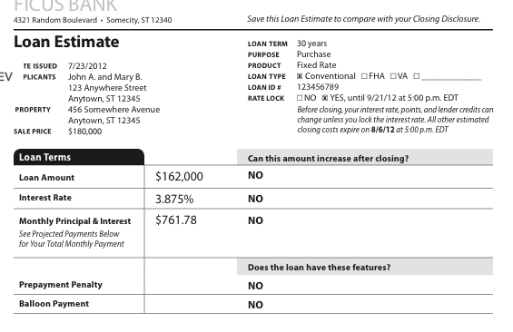
Page One
Notes:
Page 1 of the Loan Estimate includes general information, a Loan Terms table with descriptions of applicable information about the loan, a Projected Payments table, a Costs at Closing table, and a link for consumers to obtain more information about loans secured by real property at a website maintained by the Bureau.
Page 1 of the Loan Estimate includes the title “Loan Estimate” and a statement of “Save this Loan Estimate to compare with your closing disclosure.” (§ 1026.37(a)(1),(2))
The top of page 1 also includes the name and address of the creditor. A logo or slogan can be used along with the creditor’s name and address, so long as the logo or slogan does not exceed the space provided for that information.
If there are multiple creditors, use only the name of the creditor completing the Loan Estimate. (comment 37(a)(3)-1) If a mortgage broker is completing the Loan Estimate, use the name and address of the creditor if known. If not yet known, leave this space blank. (comment 37(a)(3)-2)

Slide 41
Page One: Section 1
Loan Estimate General Information
Notes:
Date Issued
The date the Loan Estimate is mailed or delivered to the consumer. (§ 1026.37(a)(4))
Applicants
Applicants includes the name and mailing address of the consumer(s) applying for the loan. use each Applicant’s name and mailing address if there are multiple Applicants. An additional page may be added to the Loan Estimate if the space provided is insufficient to list all of the Applicants. (comment 37(a)(5)-1)
Property
Property is the address of the property (which must include the zip code) that will secure the transaction. If the address of the Property is unavailable, use a description of the location of the property, for example a lot number. Always use a zip code. (Comment 37(a)(6)-1) Personal property such as furniture or appliances that also secures the credit transaction may be, but is not required to be included as Property. An additional page may not be appended to the Loan Estimate to disclose a description of personal property. (comment 37(a)(6)-2)
Sale Price or Appraised Value or Estimated Value
If the loan is for a purchase money mortgage, use Sale Price. (§ 1026.37(a)(7)(i)) If personal property is included in the Sale Price of the Property, use that price without any reduction for the appraised or estimated value of the personal property. (comment 37(a)(7)-2)
If the loan is for a transaction without a seller, use Appraised Value or Estimated Value. (comment 37(a)(7)-1)
Loan Term
Loan Term is the term of the debt obligation. describe the Loan Term as “years” when the Loan Term is in whole years. For example “1 year” or “30 years.”
(comment 37(a)(8)-1.i, -1.ii) For a Loan Term that is more than 24 months but is not whole years, describe using years and months with the abbreviations “yr.” and “mo.,” respectively. For example, a loan term of 185 months is disclosed as “15 yr., 5mo.” For a Loan Term that is less than 24 months and not whole years, use months only with the abbreviation “mo.” For example, “6 mo.” or “16 mo.” (comment 37(a)(8)-2)
Purpose
Describe the consumer’s intended use for the loan. (§ 1026.37(a)(9)) Purpose is disclosed using one of four descriptions: Purchase, Refinance, Construction, or Home Equity Loan.
Purchase is disclosed if the loan will be used to finance the Property’s acquisition. (§ 1026.37(a)(9)(i))
Refinance is disclosed if the loan will be used for the refinance of an existing obligation that is secured by the Property (even if the creditor is not the holder or servicer of the original obligation).
Construction is disclosed if the loan will be used to finance the initial construction of a dwelling on the property disclosed on the Loan Estimate. (§ 1026.37(a)(9)(iii))
Home Equity Loan is disclosed if the loan will be used for any other purpose. (§ 1026.37(a)(9)(iv))
Product
Provide a description of the loan. You are required to include two pieces of information in this disclosure:
The first piece of information is any payment feature that may change the periodic payment, which includes Negative Amortization, Interest Only, Step Payment, Balloon Payment, or Seasonal Payment. (§ 1026.37(a)(10)(ii)) Additionally, the duration of the relevant payment feature must be disclosed with a Negative Amortization, Interest Only, Step Payment, or Balloon Payment.
For example, a payment feature where there is a five-year period during which the payments cover only interest, and are not applied to the principal balance, would be disclosed as a 5 Year Interest Only for the payment feature.
Negative Amortization is when the principal balance of the loan may increase due to the addition of accrued interest to the principal balance.
Interest Only is when one or more regular periodic payments may be applied only to interest accrued and not to the principal of the loan.
Step Payment is when the scheduled variations in regular periodic payment amounts occur that are not caused by changes to the interest rate during the loan term.
Balloon Payment is when the terms of the legal obligation include a payment that is more than two times that of a regular periodic payment.
Seasonal Payment is when the terms of the legal obligation expressly provide that regular periodic payments are not scheduled between specified unit- periods on a regular basis. For example, a “teacher” loan that does not require monthly payments during summer months has a Seasonal Payment.
If the loan can be described with more than one of these descriptions, only the first applicable feature is disclosed. (§ 1026.37(a)(10)(iii)) For example, a loan that would result in both Negative Amortization and a Balloon Payment would only disclose Negative Amortization as part of Product.
The second piece of information disclosed is whether the loan uses an Adjustable Rate, Step Rate, or Fixed Rate to determine the interest rate applied to the principal balance. (§ 1026.37(a)(10)(i))
An interest rate is an Adjustable Rate if the interest rate may increase after consummation, but the rates that will apply or the periods for which they will apply are not known at consummation. (§ 1026.37(a)(10)(i)(A))
Each description must be preceded by the duration of any introductory rate or payment period, and the first adjustment period, as applicable. (§ 1026.37(a)(10)(iv)) For example, a product with an introductory rate that is fixed for the first five years and adjusts every three years starting in year 6 is a 5/3 Adjustable Rate.
When there is no introductory period for an Adjustable Rate, disclose “0.” (comment 37(a)(10)-1.i.A) For example, a product with no introductory rate that adjusts every year after consummation is a 0/1 Adjustable Rate.
An interest rate is a Step Rate if the interest rate will change after consummation and the rates that will apply and the periods for which they apply are known at consummation. (§ 1026.37(a)(10)(i)(B))
Each description must be preceded by the duration of any introductory rate or payment period, and the first adjustment period, as applicable. (§ 1026.37(a)(10)(iv)) For example, a product with a step rate that lasts for ten years, adjusts every year for five years, and then adjusts every three years for the next 15 years is a 10/1 Step Rate. (comment 37(a)(10)-1.ii)
When there is no introductory rate for a Step Rate, disclose “0” and then the applicable time period until the first adjustment. (comment 37(a)(10)-1.ii)
An interest rate is a Fixed Rate if the interest rate is not an Adjustable Rate or Step Rate. (§ 1026.37(a)(10)(i)(c))
The following are examples of Product with both pieces of information included:
Year 7 Balloon Payment, 3/1 Step Rate: a step rate with an introductory interest rate that lasts for three years and adjusts each year thereafter until a balloon payment is due in the seventh year of the loan term.
2 Year Negative Amortization: a fixed rate product with a step-payment feature for the first two years of the legal obligation that may negatively amortize.
When the time periods disclosed in Product are not in whole years, for time periods of 24 months or more, disclose the applicable fraction of a year by use of decimals rounded to two places. For time periods of 24 months or less, disclose the number of months with the abbreviation “mo.” (comment 37(a)(10)-3) For example:
An Adjustable Rate Product with an introductory interest rate for 31 months that adjusts every year thereafter is a 2.58/1 Adjustable Rate.
An Adjustable Rate Product with an introductory interest rate for 18 months that adjusts every 18 months thereafter is an 18 mo./18 mo. Adjustable Rate.
Loan Type
Loan Type is the type of the loan, such as Conventional or FHA.
For Loan Type, disclose:
Conventional if the loan is not guaranteed or insured by a Federal or State government agency,
FHA if the loan is insured by the Federal housing Administration,
VA if the loan is guaranteed by the u.S. department of Veterans Affairs, and
Other with a brief description if the loan is insured or guaranteed by another Federal or a State agency. (§ 1026.37(a)(11))
Loan ID#
Loan ID # is the creditor’s loan identification number that may be used by a creditor, consumer, and other parties to identify the transaction. The Loan ID # may contain alpha-numeric characters and must be unique to the particular transaction.
The same Loan ID # may not be used for different, but related, loan transactions (such as different loans to the same borrower). When a revised Loan Estimate is issued, the Loan ID # must be sufficient for the purpose of identifying the transaction associated with the initial Loan Estimate. (comment 37(a)(12)-1)
For more Product examples, please see comments 37(a)(10)-1, -2 and -3 in the Official Interpretations to Regulation Z.
Rate Lock
Indicate the rate is locked with Yes, indicate the rate is not locked with No. (§ 1026.37(a)(13))
When the interest rate is locked at the time of the Loan Estimate’s delivery, the date and time (including the applicable time zone) when the lock period ends must be disclosed. (§ 1026.37(a)(13)(i))
The date and time (including the applicable time zone) at which the estimated closing costs expire must be disclosed on every Loan Estimate. (§ 1026.37(a)(13)(ii))

Slide 42
Page One: Section 2
Loan Terms
Disclose in the Loan Terms table:
Loan Amount (if the amount is in whole dollars, do not disclose cents)
^{(§ 1026.37(o)(4)),}
^{Initial Interest Rate,}
Initial Monthly Principal & Interest amount,
Any adjustments to these amounts after consummation,
Whether the loan includes a Prepayment Penalty,
Whether the loan includes a Balloon Payment. (§ 1026.37(b))
Notes:
Interest Rate & Monthly Principal & Interest
If the initial Interest Rate is not known at consummation, the fully-indexed rate is disclosed; a fully-indexed rate is the interest rate calculated using the index value and margin at the time of consummation. (§ 1026.37(b)(2))
The initial principal and interest payment amount also would be calculated using the same fully-indexed rate. (§ 1026.37(b)(3))
Adjustment to Loan Amount, Interest Rate, and Monthly Principal & Interest after consummation
under the subheading Can this amount increase after closing?, if the Loan Amount, Interest Rate, or Monthly Principal & Interest amounts can increase after consummation, disclose Yes where applicable with the information pertinent to the adjustment after consummation. (§ 1026. 37(b)(6))
For an adjustment in Loan Amount, the creditor must also disclose the maximum principal balance for the transaction and the due date (expressed as the year or month in which it occurs, rather than an exact date) of the last payment that may cause the principal balance to increase, together with a statement whether the maximum principal balance may or will occur under the terms of the legal obligation. (§ 1026.37(b)(6)(i)) The date disclosed is the year in which the event occurs, counting from the due date of the initial periodic payment. (§ 1026.37(b)(8)(ii))
For an adjustment in the Interest Rate, also disclose the frequency of interest rate adjustments, the date when the interest rate may first adjust, the maximum interest rate, and the first date when the interest rate can reach the maximum interest rate. (§ 1026.37(b)(6)(ii)) The date disclosed is the year in which the event occurs, counting from the date that interest for the first scheduled periodic payment begins to accrue after consummation. (§ 1026.37(b)(8)(i)) Also, disclose and reference the Adjustable Interest Rate (AIR) Table on page 2 of the Loan Estimate. (§ 1026.37(b)(6)(ii))
For an adjustment to the Monthly Principal & Interest, the creditor would also disclose the scheduled frequency of adjustments, due date of the first adjustment, and the maximum possible amount (and the earliest date it can occur) of the Monthly Principal & Interest. In addition, if there is a period during which only interest is required to be paid, also disclose that fact and the due date of the last periodic payment of such period. (§ 1026.37(b)(6)(iii)) The date disclosed is the year in which the event occurs, counting from the due date of the initial payment. (§ 1026.37(b)(8)(ii)) Also, disclose and reference the Adjustable Payment (AP) Table on page 2.
When the Loan Amount, Interest Rate, or Monthly Principal & Interest payment cannot increase after consummation, disclose No where applicable. (§ 1026.37(b)(6))

Slide 43
Page One: Section 2 Cont’d.
Loan Terms
Notes:
Prepayment Penalty and Balloon Payment
A Prepayment Penalty is a charge imposed for paying all or part of a transaction’s principal before the date on which the principal is due. It does not include a waived third-party charge that the creditor imposes if the consumer prepays the loan’s entire principal sooner than 36 months after closing. (§ 1026.37(b)(4))
A Balloon Payment is a payment that is more than two times a regular periodic payment. (§ 1026.37(b)(5))
under the subheading Does the loan have these features?, when the loan has a Prepayment Penalty or a Balloon Payment disclose Yes, as applicable. (§ 1026.37(b)(4) and (5)) When the answer is Yes to either, also disclose, as applicable:
The maximum amount of the Prepayment Penalty and the date when the period during which the penalty may be imposed terminates. For example, As high as $3,240 if you pay off the loan in the first two years. (§ 1026.37(b)(7)(i))
The maximum amount of the Balloon Payment and the due date of such payment. For example, You will have to pay $149,263 at the end of year 7. (§ 1026.37(b)(7)(ii))

Slide 44
Page One: Section 3
Projected Payments
The Projected Payments table shows estimates of the periodic payments that the consumer will make over the life of the loan. Creditors must disclose estimates of the following periodic payment amounts in the Projected Payments table:
§ Principal & Interest; § Mortgage Insurance; § Estimated Escrow; § Estimated Total Monthly Payment; and § Estimated Taxes, Insurance, & Assessments, even if not paid with escrow funds.
The Projected Payments table also describes whether taxes, insurance, and other assessments will be paid with funds in the consumer’s escrow account.
Notes:
General Instructions
Show in one column the initial Periodic Payment (or range of payments if required) for each of Principal & Interest, Mortgage Insurance, and Estimated Escrow. (§ 1026.37(c)(1)) depending on the features of the loan, subsequent periodic payments also may be required to be disclosed. The Periodic Payment is the regularly scheduled payment of Principal & Interest, Mortgage Insurance, and Estimated Escrow. (comment 37(c)(1)(i)-1)
Initial Periodic Payment
To calculate the initial Periodic Payment, use the interest rate that will apply at closing, including any initial discounted or premium interest rate. If the interest rate at closing is not known, such as for an adjustable rate loan without an introductory fixed rate period, use the fully-indexed rate to determine the initial Periodic Payment. (comment 37(c)(1)(i)-2)
Subsequent Periodic Payments
If any of the triggering events listed below may occur during the life of the loan, add a column to show the amount of the periodic payments after the triggering event. (§ 1026.37(c)(1)(i)):
The Principal & Interest amount or range of such amount may change (for example if the loan has an adjustable rate). (§ 1026.37(c)(1)(i)(A))
Negative Amortization – for loans that have a Negative Amortization feature, the Principal & Interest amount may change when the Negative Amortization period ends under the terms of the legal obligation, meaning the consumer must begin making payments that do not result in an increase of the principal balance. (comment 37(c)(1)(i)(A)-2)
Interest Only – for Interest Only loans, the Principal & Interest amount may change when the Interest Only period ends, meaning the consumer must begin making payments that do not defer repayment of principal. (comment 37(c)(1)(i)(A)-3)
́ Minor Periodic Payment variations resulting solely from the fact that months have different numbers of days are not triggering events. (comment 37(c)(1)(i)(A)-1)
There is a scheduled Balloon Payment. (§ 1026.37(c)(1)(i)(B)) The lender must automatically terminate Mortgage Insurance or any functional
equivalent. (§ 1026.37(c)(1)(i)(c))
Even if the borrower may cancel the insurance earlier, use the date on which the lender must automatically terminate Mortgage Insurance coverage under applicable law. only termination of Mortgage Insurance is a triggering event, while a decline in Mortgage Insurance premiums is not. (comment 37(c)(1)(i)(c)-3)
When the Periodic Payment amount changes more than once in a single year, show in the subsequent column the Periodic Payment amounts in the year following the one in which there were multiple changes. (§ 1026.37(c)(1)(i)(d)) A year for this table is the 12-month period following the due date of the initial Periodic Payment. (§ 1026.37(c)(3)(ii))
Number of Columns
The maximum number of columns the Periodic Payments table may contain is four. If a loan has more than four triggering events, show a range of payments in the fourth column that reflects all remaining periodic payments not shown in the first three columns. (§ 1026.37(c)(1)(ii)) Except:
A Balloon Payment scheduled as a final payment always requires its own column. (§ 1026.37(c)(1)(ii)(A))
If disclosing the final Balloon Payment means that other triggering events will not fit within the four-column maximum, show the other triggering events as a range of payments in the third column. (§ 1026.37(c)(1)(ii)(A))
A Balloon Payment that is not a final payment is a triggering event that does not necessarily require its own column. (comment 37(c)(1)(ii)(A)-1)
The automatic termination of Mortgage Insurance generally requires the corresponding periodic payment to be shown in its own column, unless doing so would exceed the four-column maximum. (§ 1026.37(c)(1)(ii)(B))
Where the automatic termination of Mortgage Insurance need not be shown in its own column, the column showing the next periodic payment or range of payments should show the periodic payment amount without Mortgage Insurance. (comment 37(c)(1)(ii)(B)-1)
Show a range of payments rather than a single payment when:
There are more triggering events than can be shown in four columns and thus one column must be used to show two or more periodic payment amounts.
More than one of the triggering events occurs in a single year or one of the triggering events occurs in the same year as the initial periodic payment.
The Principal & Interest payment may adjust based on an interest rate index and the rates are not yet known (i.e., for an adjustable rate loan). (§ 1026.37(c)(1)(iii))
For a column that contains a range of payments, show both a minimum and maximum payment using rounded dollar amounts. (§ 1026.37(c)(1)(iii), (o)(4)(ii)) For an Adjustable Rate loan, use the maximum and minimum interest rates that could apply such as through an interest rate cap. (comment 37(c)(1)(iii)(c)-1)
Ranges of payments are required only for the Principal & Interest amount and the Estimated Total Monthly Payment. do not show a range of payments for Mortgage Insurance or Estimated Escrow. (comment 37(c)(1)(iii)-1)

Slide 45
Page One: Section 3 Cont’d.
Projected Payments
Notes:
Payment Calculation Column Headings
To the right of the Payment Calculation label, as column headings, use the years of the loan during which the payments or ranges of payments shown in that column will apply. (§ 1026.37(c)(3)(ii))
use a sequence of whole years, counting from the due date of the initial Periodic Payment.
For example, a two-column projected payments table might contain the headings “years 1-7” and “Years 8-30” if a triggering event occurs 85 months after the due date of the initial Periodic Payment. If a triggering event occurs in the middle of a year, use the next year in sequence as the heading for the subsequent column.
For example, assume a 30-year loan that requires Interest Only payments for the first 54 months from the due date of the initial Periodic Payment.
The column heading for the initial Periodic Payment would be “Years 1-5” and the column heading for the subsequent Periodic Payment would be “Years 6-30” because the triggering event occurs during the 5th year of the loan. (comment 37(c)(3)(ii)-1)
For Periodic Payments that may increase based on an adjustment of the interest rate, use the maximum loan term possible under the terms of the legal obligation. To calculate the maximum loan term, assume that the interest rate rises as rapidly as is possible under the terms of the legal obligation, taking into account any applicable interest rate caps. (comment 37(c)(3)(ii)-2)
For a Balloon Payment scheduled as a final payment, use Final Payment as the column heading. (§ 1026.37(c)(3)(iii))
Principal & Interest Use the amount due for Principal & Interest for the period shown in the column
heading. (§ 1026.37(c)(2)(i)) If the payment or range of payments includes any
payments of Interest Only, use the phrase Only Interest under the amount of the payment or range of payments.
Adjustable Rate Loans
generally, calculate Principal & Interest using the maximum payments by assuming that the interest rate will rise as rapidly as possible, taking into account the terms of the legal obligation, including any applicable caps on interest rate adjustments and lifetime interest rate cap. other laws, such as a State usury law, can set the maximum rate if the legal obligation does not include a lifetime interest rate cap. calculate the minimum payments by assuming that the interest rate will decrease as rapidly as possible, taking into account any introductory rates, caps on interest rate adjustments, and lifetime interest rate floor. For an Adjustable Rate loan based on an index that has no lifetime interest rate floor, the minimum interest rate is equal to the margin. (comment 37(c)(2)(i)-1)
For loans with a Negative Amortization feature, calculate Principal & Interest using the maximum payment amounts after the end of the period during which the principal balance may increase by assuming the maximum principal amount permitted under the terms of the legal obligation at the end of the period. calculate the minimum payment amount by assuming the interest rate is the minimum possible under the terms of the legal obligation. (comment 37(c)(2)(i)-2)
For loans with a Balloon Payment feature that may change depending on previous interest rate adjustments, calculate Principal & Interest using the assumptions for minimum and maximum interest rates described above and show as a range of payments. (comment 37(c)(2)(i)-3)
Mortgage Insurance
disclose the maximum amount payable as Mortgage Insurance that corresponds to the Principal & Interest payment shown in the same column. (§ 1026.37(c)(2)(ii)) disclose as a rounded number. (§ 1026.37(o)(4)(ii))
Mortgage Insurance includes any mortgage guarantee that provides coverage similar to mortgage insurance (such as a united States department of Veterans Affairs or united States department of Agriculture guarantee), even if not technically considered insurance under State or other applicable law.
(§ 1026.4(b)(5); comment 37(c)(1)(i)(c)-1)
calculate Mortgage Insurance premiums based on the principal balance that will exist after changes to the interest rate and payment amounts pursuant to the
legal obligation. The calculations should take into account any initial discounted or premium interest rate. For example, for an Adjustable Rate transaction that has a discounted interest rate during an initial five-year period, calculate Mortgage Insurance premiums using a composite rate based on the rate in effect during the initial five-year period and, thereafter, the fully-indexed rate, unless otherwise required by applicable law. (comment 37(c)(1)(i)(c)-2)
If Mortgage Insurance is not required, disclose “0.” (comments 37(c)(2)(ii)-1 and -2)
disclose the Mortgage Insurance amount that corresponds with the Principal & Interest amount shown in the same column, even if Mortgage Insurance is paid on a different schedule than Principal & Interest. (comment 37(c)(2)(ii)-2)
Estimated Escrow
disclose the amount the consumer will pay into an escrow account each month under the terms of the legal obligation. (§ 1026.37(c)(2)(iii)) use a rounded number. (§ 1026.37(o)(4)(ii)) If an escrow account will not be established, disclose “0.” disclose “—” if there will be an escrow account, but the escrow account will be closed during the time-frame attributable to the applicable Periodic Payment. (comment 37(c)(2)(iii)-1)
Estimated Total Monthly Payment
For each column, disclose the sum of the Principal & Interest, Mortgage Insurance, and Estimated Escrow as Estimated Total Monthly Payment. (§ 1026.37(c)(2)(iv)) The amount is rounded if any of the component amounts are rounded. (§ 1026.37(o)(4)(i)(c))

Slide 46
Page One: Section 3 Cont’d.
Projected Payments
Notes:
Estimated Taxes, Insurance & Assessments
As Estimated Taxes, Insurance & Assessments, disclose the total monthly amount due for Property Taxes, Homeowner’s Insurance, charges imposed by a cooperative, condominium or homeowners association; ground rent; leasehold payments; and certain insurance premiums or charges if required by the lender. (§§ 1026.37(c)(4)(ii), 1026.43(b)(8)) disclose Estimated Taxes, Insurance & Assessments as a rounded number. (§ 1026.37(o)(4)(i))
Homeowner’s Insurance is any insurance against loss or damage, or against liability arising out of the property. (§§ 1026.4(b)(8), 1026.37(c)(4)(ii)) The insurance premiums included as Estimated Taxes, Insurance & Assessments are for credit life, accident, health, or loss-of-income insurance; insurance against loss of or damage to property, or against liability arising out of the ownership or use of property; and debt cancellation or debt suspension coverage. (§§ 1026.4(b)(7), (8), (10), 1026.37(c)(4)(ii))
To calculate Property Taxes, Homeowner’s Insurance, and other insurance premiums, use the taxable assessed value of the real property securing the transaction after consummation, including the value of any improvements or construction, to the extent known, and the replacement costs of the property over the first year. (§ 1026.37(c)(5))
Include these amounts as Estimated Taxes, Insurance & Assessments even if an escrow account will not be established under the terms of the legal obligation.
By the use of checkboxes, disclose if Property Taxes, Homeowner’s Insurance, or Other required charges will be paid from an escrow account established under the terms of the legal obligation under the heading “This estimate includes”. When applicable, describe briefly the type of charge to the right of the word “Other”.
If there is more than one Other charge, disclose one type and the phrase and additional charges. (comment 37(c)(4)(iv)-1)
under a heading of In Escrow?: disclose Yes when an escrow account will be established that will pay the item; or disclose No when an escrow account will not be established under the terms of the legal obligation for Property Taxes, Homeowner’s Insurance, and Other. If more than one item is disclosed as Other, disclose Yes, Some when one item is included and another is not. (comment 37(c)(4)(iv)-2)

Slide 47
Page One: Section 3 Cont’d.
Costs at Closing
Estimated Closing Costs are calculated in the same manner as the Total Closing Costs disclosed on page 2 of the Loan Estimate. (See section 2.3.1 below) The Total Closing Costs are also itemized to show from page 2 of the Loan Estimate:
§ The total of the Loan Costs table, § The total of the Other Costs table, and § Lender Credits in the Total Closing Costs subheading. (§ 1026.37(d)(1)(i))
§ The estimated amount of cash the consumer will be expected to pay at closing is also shown as Estimated Cash to Close. This amount is the same as the Estimated Cash to Close, from the Calculating Cash to Close table on page 2 of the Loan Estimate. (§ 1026. 37(d)(1)(ii))
Notes:
The Costs at Closing table shows:
Estimated Closing Costs are calculated in the same manner as the Total Closing Costs disclosed on page 2 of the Loan Estimate. (See section 2.3.1 below) The Total Closing Costs are also itemized to show from page 2 of the Loan Estimate:
The total of the Loan Costs table,
The total of the Other Costs table, and
Lender Credits in the Total Closing Costs subheading. (§ 1026.37(d)(1)(i))
The estimated amount of cash the consumer will be expected to pay at closing is also shown as Estimated Cash to Close. This amount is the same as the Estimated Cash to Close, from the Calculating Cash to Close table on page 2 of the Loan Estimate. (§ 1026. 37(d)(1)(ii))

Slide 48
Page One: Section 3 Cont’d.
Alternative Costs at Closing Table
Notes:
For transactions without a seller, an Alternative Costs at Closing table together with an Alternative Calculating Cash to Close table on page 2 of the Loan Estimate can be used in place of the costs at closing table shown above. (§ 1026.37(d)(2)) The Alternative Costs at Closing table contains a variation that places checkboxes with Estimated Cash to Close in order to indicate whether the cash is due from or to the consumer. (comment 37(d)(2)-2) If the Alternative Costs at Closing table is used, then the Alternative Calculating Cash to Close on page 2 of the Loan Estimate also must be used. (comment 37(d)(2)-1)

Slide 49
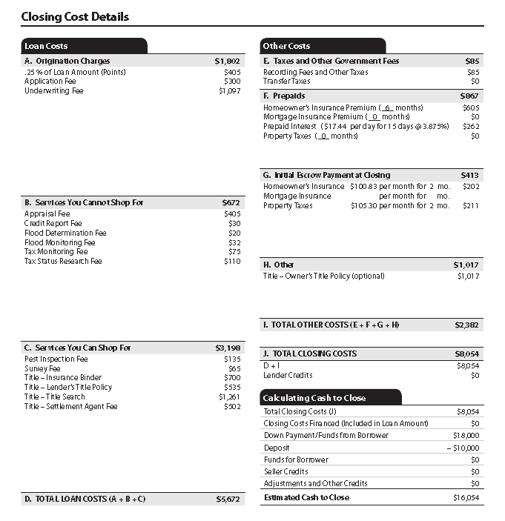
Page Two: All About the Costs
Notes:
Page two is entirely dedicated to the closing cost details. Again, novice borrowers particularly low-income first time borrowers struggle with the understanding the “cost” or price of borrowing. This does go back to the original RESPA & TILA acts. The page set up is different, but a lot of the information is the same. The information is the same just the organization and presentation is different.
There are five general sections: Itemization of LOAN Costs, Itemization of OTHER COSTS, Calculating Cash to Close, and then two tables: an Adjustable Payment Table (if there are adjustable monthly payments) and Adjustable Interest Rate (AIR) table if there are adjustable interest rates.

Slide 50
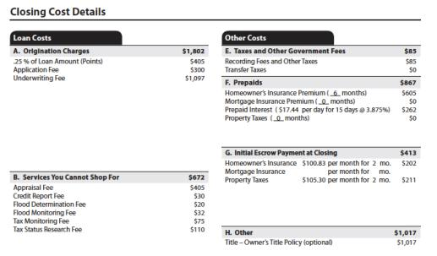
Page Two Cont’d.
Up to four main categories of costs are disclosed on page 2 of the Loan Estimate:
A good-faith itemization of the Loan Costs and Other Costs associated with the loan. (§ 1026.37(f) and (g))
A Calculating Cash to Close table that shows how the amount of cash needed at closing is calculated. (§ 1026.37(h))
For transactions with adjustable monthly payments, an Adjustable Payments (AP) Table with relevant information about how the monthly payments will change. (§ 1026.37(i))
For transactions with adjustable interest rates, an Adjustable Interest Rate (AIR) Table with relevant information about how the interest rate will change. (§ 1026.37(j))
Notes:
Up to four main categories of costs are disclosed on page 2 of the Loan Estimate:
A good-faith itemization of the Loan Costs and Other Costs associated with the loan. (§ 1026.37(f) and (g))
A Calculating Cash to Close table that shows how the amount of cash needed at closing is calculated. (§ 1026.37(h))
For transactions with adjustable monthly payments, an Adjustable Payments (AP) Table with relevant information about how the monthly payments will change. (§ 1026.37(i))
For transactions with adjustable interest rates, an Adjustable Interest Rate (AIR) Table with relevant information about how the interest rate will change. (§ 1026.37(j))
The items associated with the mortgage are broken down into two general types, Loan Costs and Other Costs. generally, Loan Costs are those costs paid by the consumer to the creditor and third-party providers of services the creditor requires to be obtained by the consumer during the origination of the loan. (§ 1026.37(f)) Other Costs include taxes, governmental recording fees, and certain other payments involved in the real estate closing process. (§ 1026.37(g))
Items that are a component of title insurance or are for conducting the closing must include the introductory description of Title –. (§§ 1026.37(f)(2)(i), (g)(4)(i))
If State law requires additional disclosures, those additional disclosures are made on a document whose pages are separate from, and not presented as part of, the Loan Estimate. (comments 37(f)(6)-1, 37(g)(8)-1)
The amounts disclosed in the Loan Costs and Other Costs table are rounded to the nearest whole dollar. The daily amount of Prepaid Interest and the monthly amounts for the items in the Initial Escrow Payment at Closing in the labels are not rounded, but the calculated amounts for those items are rounded to the nearest whole dollar. (§ 1026.37(o)(4))
The Loan Costs and Other Costs tables are further broken down in the next subsection.

Slide 51
Loan Costs vs. Other Costs
Paid by the Consumer to the creditor or third-party provider
Consumer must pay during the origination of the loan
Applicable taxes
Government recording fees
Other payments involved in the real estate closing process
Notes:
Generally, Loan Costs are those costs paid by the consumer to the creditor and third-party providers of services the creditor requires to be obtained by the consumer during the origination of the loan. (§ 1026.37(f)). Other Costs include taxes, governmental recording fees, and certain other payments involved in the real estate closing process. (§ 1026.37(g))

Slide 52
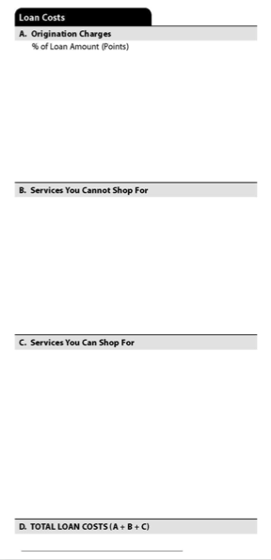
Page Two: Section 1
Loan Costs
Loan Costs are disclosed in three subheadings, each of which is subtotaled:
§ Origination Charges, § Services You Cannot Shop For, and § Services You Can Shop For.
Disclose the sum of these three subtotals as Total Loan Costs. (§ 1026.37(f))
Notes:
Origination Charges
Origination Charges are items the consumer will pay to each creditor and loan
originator for originating and extending credit. (§ 1026.37(f)(1))
First, include the amount paid, if any, by the consumer to the creditor to reduce the interest rate (sometimes referred to as “points”) as both a percentage of the loan amount and a dollar amount. (§ 1026.37(f)(1)(i)) If no points are charged, then leave blank both the percentage of points stated in the label and the dollar amount. (comment 37(f)(1)-4)
Any other items that the consumer will pay to the creditor and loan originator may also be disclosed, up to 13 individual items. (§ 1026.37(f)(1)(ii)) If there are more than 13 Origination Charges, disclose the total amount of the items that exceed 12 as Additional Charges. (§ 1026.37(f)(6)(i)) describe the items, other than for points paid, using terminology that clearly and conspicuously describes the service that is disclosed. (comment 37(f)(1)-3)
The following items should be itemized separately in the Origination Charges subheading:
Compensation paid directly by a consumer to a loan originator that is not also the creditor; or
Any charge imposed to pay for a loan level pricing adjustment assessed on the creditor that is passed on to the consumer as a cost at consummation and not as an adjustment to the interest rate. (comment 37(f)(1)-5)
Only items paid directly by the consumer to compensate a loan originator are Origination Charges. do not disclose compensation to a loan originator paid indirectly by a creditor through the interest rate on the Loan Estimate. (comment 37(f)(1)-2)
Services You Cannot Shop For
Services You Cannot Shop For are items provided by persons other than the creditor or mortgage broker that the consumer cannot shop for and will pay for at settlement. (§ 1026.37(f)(2)) Items listed as Services You Cannot Shop For must use terminology that describes each item, and disclose them in alphabetical order. (§ 1026.37(f)(5))
Services You Cannot Shop For might include:
Appraisal fee,
Appraisal management company fee,
credit report fee,
Flood determination fee,
government funding fee (such as a VA or USA guarantee fee, or any other fee paid to a government entity as part of a governmental loan program),
Homeowner’s association certification fee,
Lender’s attorney fee, § Tax status search fee,
Third-party subordination fee,
Title – closing protection letter fee,
Title – lender’s title insurance policy, and
An upfront mortgage insurance fee (unless the fee is a prepayment of future premiums or a payment into an escrow account). (comment 37(f)(2)-2) describe services related to the issuance of title insurance policies with the word Title – at the beginning of the item. (comment 37(f)(2)-3)
Items that are required for the issuance of title insurance policies may include:
Examination and evaluation of title evidence to determine the insurability of the title being examined and what items to include or exclude in any title commitment and policy to be issued,
Preparation and issuance of the title commitment or other document that discloses the status of title, identifies the conditions that must be met before the policy will be issued, and obligates the insurer to issue a policy of title insurance if such conditions are met,
Resolution of title underwriting issues and taking steps needed to satisfy any conditions for the issuance of title insurance policies,
Preparation and issuance of the title insurance policies, and
Payment of premiums for any lender’s title insurance coverage.
(comment 37(f)(2)-3)
The amount of the premium for the lender’s title insurance coverage must be disclosed without any adjustment to the premium that might be made for the simultaneous purchase of an owner’s title insurance policy. (comment 37(f)(2)-4)
disclose no more than 13 Services You Cannot Shop For. (§ 1026.37(f)(2)(ii)) If there are more than 13 Services You Cannot Shop For, disclose the total amount of the items that exceed 12 with the label Additional Charges. An addendum to the Loan Estimate cannot be used to disclose the additional items. (§ 1026.37(f)(6)(i))
Services You Can Shop For
Services You Can Shop For are provided by persons other than the creditor or mortgage broker and are services that the consumer can shop for and will pay for at settlement. (§ 1026.37(f)(3)) Items listed as Services You Can Shop For must use terminology that describes each item and disclose them in alphabetical order. (§ 1026.37(f)(5))
A creditor permits a consumer to shop for an item if the creditor permits the consumer to select the provider of that item, subject to reasonable requirements (such as appropriate licensing of the provider). (§ 1026.19(e)(1)(vi)(A); comment 19(e)(1)(vi)-1)
Services You Can Shop For might include:
Pest inspection fee,
Survey fee,
Title – closing agent fee, and
Title – closing protection letter fee. (comment 37(f)(3)-2) describe services related to the issuance of title insurance policies with the word Title – at the beginning of the item. (comment 37(f)(2)-3)
Items that are required for the issuance of title insurance policies may include:
Examination and evaluation of title evidence to determine the insurability of the title being examined and what items to include or exclude in any title commitment and policy to be issued,
Preparation and issuance of the title commitment or other document that discloses the status of title, identifies the conditions that must be met before the policy will be issued, and obligates the insurer to issue a policy of title insurance if such conditions are met,
Resolution of title underwriting issues and taking steps needed to satisfy any conditions for the issuance of title insurance policies,
Preparation and issuance of the title insurance policies, and
Payment of premiums for any lender’s title insurance coverage.
(comment 37(f)(3)-3)
The creditor must disclose the amount of the premium for the lender’s title insurance coverage without any adjustment to the premium that might be made for the simultaneous purchase of an owner’s title insurance policy. (comment 37(f)(3)-3)
disclose no more than 14 Services You Can Shop For. (§ 1026.37(f)(3)(ii)) If there are more than 14 Services You Can Shop For, disclose the total amount of the items that exceed 13 with the label Additional Charges. (§ 1026.37(f)(6)(ii)(B)) An addendum to the Loan Estimate can be used to disclose the additional items. (§ 1026.37(f)(6)(ii))
Total Loan Costs
Total Loan Costs is the sum of the subtotals of Origination Charges, Services You
Cannot Shop For, and Services You Can Shop For. (§ 1026.37(f)(4))

Slide 53
Consumer Shopping for a Service Notes
If the consumer is permitted to shop for a service, the creditor must provide the consumer with a written list of services for which they can shop.
The written list of providers is separate from the Loan Estimate
Must be provided within the same 3-day time period
Must have at least one available service provider for each service
Must state that the consumer may choose a different provider (H-27(A) and H-27(C) of the appendix for model forms & language)

Slide 54
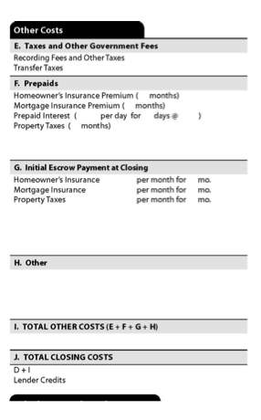
Page Two: Section 2
Other Costs
Disclose Other Costs under four subheadings, each of which is subtotaled:
§ Taxes and Other Government Fees,
§ Prepaids, § Initial Escrow Payment at Closing, and § Other.
Total Other Costs is the sum of these four subtotals. (§ 1026.37(g)(5))
Notes:
Disclose Other Costs under four subheadings, each of which is subtotaled:
Taxes and Other Government Fees,
Prepaids,
Initial Escrow Payment at Closing, and
Other. Total Other Costs is the sum of these four subtotals. (§ 1026.37(g)(5))
Other Costs are established by government action, determined by standard calculations applied to ongoing fixed costs, or based on an obligation incurred by the consumer independently of any requirement imposed by the creditor. (comment 37(g)-1) other items that are required to be paid at or before closing pursuant to the contract for sale between the consumer and a seller are disclosed on the Loan Estimate to the extent the creditor has knowledge of those items when it issues the Loan Estimate. (comment 37(g)-2)
Other Costs must be disclosed in the order listed in the regulation, with any additional items listed in alphabetical order in subsequent lines of the applicable subheading. (§ 1026.37(g)(7))
An addendum to the Loan Estimate cannot be used for additional items on the Other Costs table. If all of the charges cannot be itemized in the number of lines provided in a subheading of the Other Costs table, the total of those items that exceed the number permitted are disclosed with the label “Additional charges” on the last line of that subheading. (§ 1026.37(g)(8))
Taxes and Other Government Fees
Under Taxes and Other Government Fees, disclose Recording Fees and Other Taxes first and Transfer Taxes second. (§ 1026.37(g)(1))
Recording Fees and Other Taxes are fees assessed by a government authority to record and index the loan and title documents as required under State or local law, together with any charges or fees imposed by a State or local government that are not Transfer Taxes. (comment 37(g)(1)-1 and -2) Recording Fees and Other Taxes do not include fees that are based on the Sale Price of the Property or Loan Amount. For example, a fee for recording a over three pages, is included as Recording Fees and Other Taxes; but a fee of $1,250 based on 0.5% of the Loan Amount is included as Transfer Taxes, and not included as Recording Fees and Other Taxes. (comment 37(g)(1)-1)
Transfer Taxes are State and local government fees on mortgages and home sales that are based on the Loan Amount or Sale Price of the Property. The name that is used under State or local law to refer to these amounts is not determinative of whether or not they are disclosed as Transfer Taxes on the Loan Estimate. (comment 37(g)(1)-3)
disclose only Transfer Taxes paid by the consumer on the Loan Estimate. Whether the consumer pays the transfer tax is based on applicable State or local law. For example:
If a State law indicates a lien can attach to the consumer’s acquired property if the charge is not paid, the amount is included as part of Transfer Taxes;
If State or local law is unclear or does not specifically attribute the amount to the seller or consumer, disclose the amount apportioned to the consumer using common practice in the locality of the property. (comment 38(g)(1)-4)
Transfer taxes to be paid by the seller are not disclosed on the Loan Estimate as Transfer Taxes. (comment 38(g)(1)-5)
The amount of Transfer Taxes disclosed could be modified to the extent the creditor has knowledge of the apportionment of transfer taxes in the contract for sale between the consumer and a seller when it issues the Loan Estimate. (comment 37(g)-2) When a creditor does not have the contract of sale when it issues the Loan Estimate, the creditor must use the apportionment of transfer taxes provided for by State or local law, or common practice when State or local law is unclear. (comment 37(g)(1)-4)
disclose the sum of all transfer taxes paid by the consumer as Transfer Taxes. (§ 1026.37(g)(1)(ii)) no additional items may be listed or deleted in the Taxes and Other Government Fees category. (comment 37(g)(1)-6)
Prepaids
Prepaids are items to be paid by the consumer in advance of the first scheduled payment of the loan. (§ 1026.37(g)(2))
Prepaids are:
Homeowner’s Insurance Premium,
Mortgage Insurance Premium,
Prepaid Interest,
Property Taxes, and
A maximum of three additional items.
Each item must include the applicable time period covered by the amount to be paid by the consumer and the total amount to be paid. (§ 1026.37(g)(2)(i)-(iv))
Initial Escrow Payment at Closing
Initial Escrow Payment at Closing includes items that the consumer will be expected to place into a reserve or escrow account at consummation to be applied to recurring periodic payments. (§ 1026.37(g)(3)) Initial Escrow Payment at Closing includes:
homeowner’s Insurance,
Mortgage Insurance,
Property Taxes, and
A maximum of five other items. Also disclose the amount escrowed per month for each item, the number of months
collected at consummation and the total amount paid. (§ 1026.37(g)(3)(i), (ii), (iii), (v))
Other
Other includes items in connection with the transaction that the consumer is likely to pay or has contracted with a person other than the creditor or loan originator to pay at closing and of which the creditor is aware at the time of issuing the Loan Estimate. (§ 1026.37(g)(4))
Separate insurance, warranty, guarantee or event-coverage products include, for example:
Owner’s title insurance,
Credit life insurance,
Debt suspension coverage,
Debt cancellation coverage,
Warranties of home appliances and systems, and
Similar products.
These items are disclosed when coverage is written in connection with a mortgage. These examples would not include additional coverage and endorsements on insurance otherwise required by the creditor. (comment 37(g)(4)-3)
Items that disclose any premiums paid for separate insurance, warranty, guarantee, or event-coverage products not required by the creditor must include the parenthetical description (optional) at the end of the label. (§ 1026.37(g)(4)(ii))
A maximum of five items can be disclosed as Other. (§ 1026.37(g)(4)(iii)) describe services related to the issuance of title insurance policies with the word Title – at the beginning of the item. When the owner’s title insurance premium includes a simultaneous issuance premium, the premium is calculated by taking the full owner’s title insurance premium, adding the simultaneous issuance premium for the lender’s coverage (if any), and then deducting the full premium for lender’s coverage. (comment 37(g)(4)-2)
When the creditor is aware of those items, Other includes for example:
Commissions of real estate brokers or agents,
Additional payments to the seller to purchase personal property pursuant to the contract of sale,
Homeowner’s association and condominium charges associated with the transfer of ownership, and
Fees for inspections not required by the creditor but paid by the consumer pursuant to the contract of sale. (comment 37(g)(4)-4)
Total Closing Costs
Total Closing Costs is the sum of Total Loan Costs (shown in Figure 8), Total Other
Costs, and Lender Credits. (§ 1026.37(g)(6))
Lender Credits is the amount of any payments from the creditor to the consumer that do not pay for a particular fee on the Loan Estimate and is disclosed as a negative number. (comment 37(g)(6)(ii)-1)
For loans where all or a portion of closing costs are offset by a credit or rebate provided by the creditor (sometimes referred to as “no cost” loans), disclose such credit or rebate as Lender Credits. The creditor should ensure that Lender Credits is sufficient to cover the estimated items the creditor represented to the consumer as not being paid by the consumer at consummation, regardless of whether such representations pertained to specific items. (Comment 37(g)(6)(ii)-2)

Slide 55
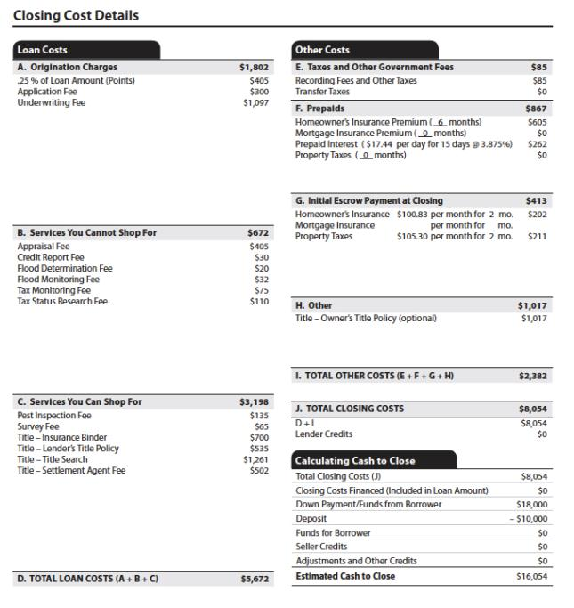
Timing of Charges
Cannot charge fees until after new form is given AND consumer has communicated intent to proceed.
Credit reports are an exception.
Notes:
Consistent with current law, the creditor generally cannot charge consumers any fees until after the consumers have been given the Loan Estimate form and the consumers have communicated their intent to proceed with the transaction. There is an exception that allows creditors to charge fees to obtain consumers’ credit reports.

Slide 56
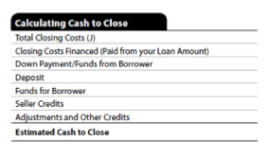
Page Two: Section 3
Calculating Cash to Close
Notes:
Total Closing Costs
Total Closing Costs is the same amount disclosed as Total Closing Costs in the Other Costs table (see section 2.3.2 above). The amount is disclosed as a positive number. (§ 1026.37(h)(1)(i))
Closing Costs Financed (Paid from Your Loan Amount)
Closing Costs Financed (Paid from Your Loan Amount) is calculated by subtracting the estimated total amount of payments to third parties not otherwise disclosed in the Loan Costs (see section 2.3.1 above) and Other Costs (see section 2.3.2 above) tables from the Loan Amount disclosed on page 1 of the Loan Estimate (see section 2.2.2 above).
If the result of the calculation is a positive number, Closing Costs Financed (Paid from Your Loan Amount) is that amount, disclosed as a negative number, but only to the extent that it does not exceed the amount of Lender Credits.
If the result of the calculation is zero or negative, then Closing Costs Financed (paid from Your Loan Amount) is $0. (comment 37(h)(1)(ii)-1)
Down Payment/Funds from Borrower
In a Purchase transaction, Down Payment/Funds from Borrower is the difference between the purchase price of the property and the principal amount of the loan, disclosed as a positive number. (§ 1026.37(h)(1)(iii)(A)) however, when the loan amount exceeds the purchase price of the property, disclose $0 as Down Payment/Funds from Borrower. (comment 37(h)(1)(iii)-1)
In all other transactions, subtract the principal amount of credit extended (excluding any amount disclosed as Closing Costs Financed (Paid from Your Loan Amount)) from the total amount of all existing debt being satisfied in the transaction.
When this calculation yields an amount that is positive, Down Payment/ Funds from Borrower is that amount.
If the calculation yields a result that is negative or $0, Down Payment/ Funds from Borrower is $0. (§ 1026.37(h)(1) (iii)(B))
Deposit
In a Purchase transaction, Deposit is the amount, disclosed as a negative number, that is paid to the seller or held in trust or escrow by an attorney or other party under the terms of the contract for sale of the property. (§ 1026.37(h)(1)(iv)(A))
In all other transactions, Deposit is $0. (§ 1026.37(h)(1)(iv)(B))
Funds for Borrower
In a Purchase transaction, Funds for Borrower is $0. (comment 37(h)(1)(v)-1)
In all other transactions, subtract the principal amount of debt extended (excluding any amount disclosed as Closing Costs Financed (Paid from Your Loan Amount)) from the total amount of all existing debt being satisfied in the transaction.
When this calculation yields an amount that is negative, then Funds for Borrower is that amount.
If the calculation yields an amount that is positive or $0, then Funds for Borrower is $0. (§ 1026.37(h)(1)(v))
Seller Credits
Seller Credits is the total amount that the seller will pay for items included in the Loan Costs and Other Costs tables, to the extent known, disclosed as a negative number. (§ 1026.37(h)(1)(vi))
Adjustments and Other Credits
Adjustments and Other Credits is the total amount of all items in the Loan Costs and Other Costs tables that are paid by persons other than the loan originator, creditor, consumer, or seller, together with any other amounts that are required to be paid by the consumer at closing pursuant to the contract of sale (if any), disclosed as a negative number. (§ 1026.37(h)(1)(vii))
Examples of items that are paid by persons other than the loan originator, creditor, consumer, or seller include:
gifts from family members, and
credits from a developer or home builder to be applied to items in the Loan Costs and Other Costs table. (comment 37(h)(1)(vii)-1 and -2)
Adjustments and Other Credits includes funds provided to the consumer from the proceeds of subordinate financing, local or State housing assistance grants, or other similar sources. (comment 37(h)(1)(vii)-5)
Examples of amounts to be paid by the consumer at closing pursuant to the contract of sale include:
Charges for personal property to be acquired by the consumer,
Probations for property taxes, and
Probations for homeowner’s association dues.
Adjustment and Other Credits is reduced by the amount of any such additional charges. (comment 38(h)(1)(vii)-6)
Estimated Cash to Close
Estimated Cash to Close is calculated as the sum of the seven other amounts disclosed in the Estimated Cash to Close table. (§ 1026.37(h)(1)(viii))

Slide 57
Points to Remember: Calculating Cash to Close
Total Closing Costs: from above under Other Costs and must be a positive number
Closing Costs Financed: Calculated by the estimated total payments to 3rd Parties not disclosed in Loan Costs & Other Costs; Can be a negative or Zero
Deposit: Negative number
Funds for Borrower: Always $0 for purchase transactions or for other transactions Negative or 0.
Notes:
Down Payment is difference between the purchase price and the loan amount; Must be a positive Number.
Seller Credits is the total amount that the seller will pay for items included in the Loan Costs and Other Costs tables, to the extent known, disclosed as a negative number. (§ 1026.37(h)(1)(vi))
Adjustments and other credits includes things like gifts from family members or builder credits and should always be disclosed as a negative number.

Slide 58
Page Two: Section 3 Cont’d.
Alternative Calculating Cash to Close table for transactions without a seller
Notes:
An optional Alternative Calculating Cash to Close table can be disclosed for transactions without a seller. This Alternative calculating cash to close table would be used in place of the table in Figure 19. (§ 1026.37(h)(2)) A creditor that uses the optional Alternative Calculating Cash to Close table must also use the alternative disclosure provisions of the Alternative Costs at Closing table on Loan Estimate page 1. (see section 2.2.4 above; comment 37(h)(2)-1)
Loan Amount
The amount disclosed as Loan Amount is the same amount disclosed as Loan Amount on Loan Estimate page 1. (see section 2.2.2 above; § 1026.37(h)(2)(i))
Total Closing Costs
Total Closing Costs is the same amount as Total Closing Costs in the Other Costs table, disclosed as a negative number. (§ 1026.37(h)(2)(ii))
Estimated Payoffs and Payments
Estimated Payoffs and Payments is the total amount to be paid to third parties not otherwise disclosed as items in the Loan Costs or Other Costs tables, disclosed as a negative number. (§ 1026.37(h)(2)(iii))
Examples of the Payoffs and Payments to be made to third parties not otherwise disclosed in the Loan Costs or Other Costs tables can include:
Payoffs of existing liens secured by the property such as mortgages, deeds of trust, judgments that have attached to the property,
Mechanics’ and materialmans’ liens,
Local, State, and Federal tax liens,
Payments of unsecured outstanding debts of the consumer, and
Payments to other third parties for outstanding debts of the consumer as required to be paid as a condition for the extension of credit. (comment 37(h)(2)(iii)-1)
Estimated Cash to Close
The amount for the Estimated Cash to Close is the sum total of the amounts disclosed as Loan Amount, Total Closing Costs, and Payoffs and Payments. (§ 1026.37(h)(2)(iv)) check boxes are used to disclose whether the Estimated Cash to Close is either due from the consumer or will be paid to the consumer at consummation. (comment 37(h)(2)(iv)-1)
Estimated Closing Costs Financed
Closing Costs Financed is the sum of Loan Amount and Payoffs and Payments, but only to the extent the amount is greater than zero and less than or equal to the sum of Total Closing Costs. (§ 1026.37(h)(2)(v))
For example:
If the Loan Amount is $100,000, the Payoffs and Payments is -$80,000, and the Total Closing Costs is $10,000; then the Closing Costs Financed would be $10,000.
If the Loan Amount is $100,000, the Payoff and Payments is -$95,000, and the Total Closing Costs is $10,000; then the Closing Costs Financed would be $5,000.
If the Loan Amount is $100,000, the Payoffs and Payments is -$110,000 and the Total Closing Costs is $10,000; then the Closing Costs Financed would be $0.

Slide 59
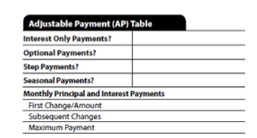
Page Two: Section 4
Adjustable Payment (AP) Table
Notes:
The Adjustable Payment (AP) Table
This is disclosed when the periodic principal and interest payment may change after consummation, but not because of a change to the interest rate, or the loan is considered to be a Seasonal Payment product. (§ 1026.37(i)) If the loan does not contain these features, the AP Table is not disclosed. (comment 37(i)-1)
The AP Table includes the following information (§ 1026.37(i)):
Whether there are Interest Only Payments, and, if so, the period during which the interest only payment would apply (§ 1026.37(i)(1));
Whether the amount of any periodic payment can be selected by the consumer as an Optional Payment and, if so, the period during which the consumer can select optional payments (§ 1026.37(i)(2));
Whether the loan is a Step Payment product and, if so, the period during which the regular periodic payments are scheduled to increase (§ 1026.37(i)(3));
Whether the loan is a Seasonal Payment product, and, if so, the period during which the periodic payments are not scheduled (§ 1026.37(i)(4));
A subheading of Monthly Principal and Interest Payments (§ 1026.37(i)(5)), that also lists:
As First Change/Amount, the number of the payment that may change, counting from the first periodic payment due after consummation, and the amount or range of the periodic principal and interest payment for such payment (§ 1026.37(i)(5)(i));
The frequency of Subsequent Changes to the periodic payment (§ 1026.37(i)(5)(ii)); and
The Maximum Payment that may be paid during the term of the loan with the number of the first periodic principal and interest payment that can reach such Maximum Payment amount. (§ 1026.37(i)(5)(iii))
First Change/Amount
If the exact payment number of the first payment adjustment is not known at the time of the Loan Estimate, the earliest possible payment that may change must be disclosed. (comment 37(i)(5)-2)
Monthly Principal and Interest Payments
The label “Monthly Principal and Interest Payments” can be changed to reflect a payment schedule that is not monthly, such as Biweekly or Annual. (comment 37(i)(5)-1)
disclose any scheduled periodic payment that only covers some or all of the interest that is due and not any principal as Monthly Principal and Interest Payments, even though the AP Table refers to Monthly Principal and Interest Payments. (comment 37(i)(5)-5)

Slide 60
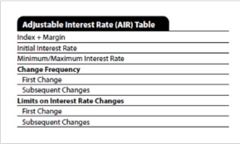
Page Two: Section 5
Adjustable Interest Rate (AIR) Table
Notes:
The Adjustable Interest Rate (AIR) Table
This is disclosed when the loan’s interest rate may increase after consummation. (§ 1026.37(j)) If the loan’s interest rate will not increase after consummation, the AIR Table is not disclosed. (comment 37(j)-1)
The AIR Table includes the following information (§ 1026.37(j)):
As Index + Margin, the index upon which adjustments to the interest rate will be based and the margin that is added to the index to determine the interest rate (§ 1026.37(j)(1));
For Step Rate products, the maximum amount of any adjustments to the interest rate that are scheduled and pre-determined (§ 1026.37(j)(2));
The Initial Interest Rate at consummation (§ 1026.37(j)(3));
The Minimum/Maximum Interest Rate for the loan, after any introductory
period expires (§ 1026.37(j)(4));
As Change Frequency (§ 1026.37(j)(5)):
́ For First Change, list the month when the first interest rate change may occur after consummation (§ 1026.37(j)(5)(i)); and
As Subsequent Changes, the frequency of interest rate adjustments after the initial adjustment (§ 1026.37(j)(5)(ii)); and
As Limits on Interest Rate Changes (§ 1026.37(j)(6)):
As First Change, the maximum possible change for the first adjustment of the interest rate after consummation (§ 1026.37(j)(6)(i)); and
As Subsequent Changes, the maximum possible change for subsequent adjustments of the interest rate. (§ 1026.37(j)(6)(ii))
Index and Margin
The index must be described such that a consumer can reasonably identify it. For example, LIBoR may be used instead of the London Interbank offered Rate. The margin should be disclosed as a percentage. For example, if the interest rate is calculated by adding 4.25 to LIBoR, the margin should be disclosed as 4.25%. (comment 37(j)(1)-1)
Maximum/Minimum Interest Rate
The maximum interest rate that applies to the loan under applicable law, such as State usury law, must be disclosed if the loan does not provide for a maximum interest rate. (comment 37(j)(4)-2)
applicable law does not set a minimum interest rate, disclose the amount of the margin as the minimum interest rate. (comment 37(j)(4)-1)
Change Frequency
Typically, the first change month for the interest rate is scheduled in the terms of the loan, but if the exact month is not known at the time creditor provides the Loan Estimate, the earliest possible month for the first change to the interest rate of the loan must be disclosed based on the best information available to the creditor at the time the Loan Estimate is disclosed. (comment 37(j)(5)-1)
Limits on Interest Rate Changes
The greatest limit on changes in the interest rate must be disclosed when more than one limit applies to changes in the interest rate. For example, if the initial interest rate adjustment is capped at 2%, the second adjustment is capped at 2.5%, and all subsequent adjustments are capped at 3%, 3% is disclosed as Subsequent Changes. (comment 37(j)(6)-1)

Slide 61
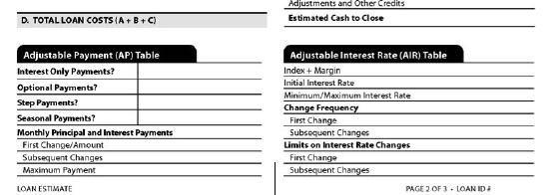
The New Tables are NOT always present
Adjustable Payment (AP)Table: only when the periodic principal & interest payments may change after consummation. If loan does not contain these features, this table is not disclosed.
Adjustable Interest Rate (AIR)Table: Disclosed when the loan’s interest rate may increase after consummation.

Slide 62
Page 3: Miscellaneous Items
Contact information for creditor & loan officer (this is where mortgage loan originator info and broker/vendor goes)
Comparisons
Definitions (standard)
APR calculation
Optional consumer signature
Notes:
A lot of the information on the page 3 will not change. Should be the easiest page to complete.
The Comparisons will likely be the most difficult part of Page 3

Slide 63
Page Three: Section 1
Contact Information
Notes:
Contact Information
Disclose the Name and NMLS/___License ID number for the creditor and mortgage broker, if any, and the individual loan officer of both. Also, disclose the Email and/or Phone number of the individual loan officer. The person identified as the individual loan officer must be the primary contact for the consumer. (§ 1026.37(k))
This is SAFE ACT related and trying to make the SAFE Act more pertinent.

Slide 64
Page Three: Section 2
Comparisons
Notes:
Comparisons
The Comparisons table discloses information related to the costs of the loan In Five
Years, the Annual Percentage Rate (APR), and the Total Interest Percentage (TIP).
In 5 Years
In 5 Years includes the following information:
The total amount the consumer will have paid in principal, interest, mortgage insurance, and loan costs paid through the end of the 60th month after the due date of the first periodic payment; and
The amount of principal paid through the end of the 60th month after the due date of the first periodic payment. (§ 1026.37(l)(1))
Annual Percentage Rate (APR)
Disclose the APR, together with a brief descriptive statement, in the Comparisons table on page 3. For information on how to calculate the APR, see § 1026.22 and appendix J to Regulation Z. (§ 1026.37(l)(2))
Total Interest Percentage (TIP)
The TIP is the total amount of interest that the consumer will pay over the loan term, expressed as a percentage of the loan amount. (§ 1026.37(l)(3))
For example, if the Loan Amount is $100,000 and the total amount of interest that the consumer will pay over the Loan Term is $50,000, then the TIP is 50%.

Slide 65
What Happened to the APR?
APR calculation is not changing (same)
All-inclusive APR dropped from final rule.
Notes:
Here is the APR. Remember the APR used to be on the front page of the TILA forms and was so much bigger. The idea in the 70s when TILA passed was that the APR was what consumers would compare to shop for credit. It had to be put on everything including advertising. But it never really caught on. Borrowers after thirty years are still much more interested in the loan rate than the APR. That’s why its on the last page. The laws still say it has to be on advertising. So it is still here. But the CFPB is acknowledging that the APR isn’t as important as they wanted it to be.
The TIP is defined as the total amount of interest that you will pay over the loan term as a percentage of your loan amount. CFPB has guidance on how to calculate this. 1. assume the consumer makes each payment in full and on time, for adjustable rate products the TIP should reflect a composite annual percentage rate, for step rate products, the lender computes the TIP based on the disclosed interest rate schedule. THIS is ENTIRELY NEW– so you will have to adapt your systems to calculate it and train your people. CFPB has some aids for this.

Slide 66
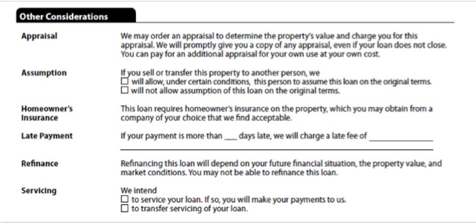
Page Three: Section 3
Other Considerations
Notes:
Other Considerations
Other Considerations includes the following information:
Appraisal;
As Assumption, whether the subsequent purchaser of the property can assume the loan on its original terms;
At the option of the creditor, a statement that homeowner’s Insurance is required and that the consumer may choose the provider;
A statement detailing any amount that may be imposed for a Late Payment;
A statement about the nature of a Refinance of the loan in the future;
A statement whether the creditor intends to service the loan or transfer it to another servicer; and
For Refinance transactions, a statement relating to State law protections against Liability After Foreclosure. (§ 1026.37(m))
Appraisal
A statement concerning the Appraisal must be provided for:
higher-priced Mortgage Loans, and
Loans covered by the Equal credit opportunity Act. (§ 1026.37(m)(1))
If the loan is a Higher-priced Mortgage Loan, but is not covered by the Equal Credit Opportunity Act, the word “promptly” may be removed from the language provided on the model form. (comment 37(m)(1)-1)
Late Payment
An increase in the interest rate triggered by a Late Payment is a charge for late payment. The following are not charges for Late Payment:
The right of acceleration;
Fees imposed for actual collection costs;
Referral and extension charges; or
Interest charged at the contract rate after the payment due date. (comment 37(m)(4)-1)

Slide 67
Pg. 3 Section 3 continued
Notes:
Refinance: This is a standard warning. So all this should be fairly boilerplate.
Servicing is a yes/no question. NOTE this does not eliminate the Servicing Notice, even though it does the same thing.

Slide 68
Page Three: Section 4
OPTIONAL: Confirm Receipt
Notes:
Confirm Receipt
The consumer is not required to sign the Loan Estimate. The creditor may add a signature statement and have the consumer sign page 3 of the Loan Estimate in order to Confirm Receipt of the Loan Estimate by the consumer. If used by the creditor, the signature statement must contain the exact language from the model form. (§ 1026.37(n)(1))
If the Confirm Receipt table is not used by a creditor, a statement about Loan Acceptance must be included at the end of the Other Consideration table that states, “You do not have to accept this loan because you have received this form or signed a loan application.” (§ 1026.37(n)(2))

Slide 69
Should I Have the Customer Sign for the Disclosures?
Lenders are permitted to get the signature of consumer to confirm receipt, but is not required.
There are pros and cons either way.
Notes:
Recognizing that consumers may work more closely with a mortgage broker than with the creditor, under the final rule and similar to current rules, either a mortgage broker or creditor is required to provide the Loan Estimate form upon receipt of an application by a mortgage broker. However, even if the mortgage broker provides the Loan Estimate, the creditor remains responsible for complying with the all requirements concerning provision of the form.

Slide 70
Can I have Brokers or third-party Provide the Loan Estimate?
Yes, yes you can.
But, the creditor is still responsible for the accuracy of the Loan Disclosure.

Slide 71
Summary: New Items on Loan Estimator
Estimated property value (application)
Loan purpose and type (definitions)
Product (definitions)
CFPB web site reference
Details about mortgage insurance premiums & property taxes
5-year estimate changed
Notes:
They added the estimate of property value which we have already discussed. The loan purpose and types and products was more just making the forms more up to date than the 1970s ones. Of course, CFPB instead of HUD address. The Details on insurance & taxes is new and will be more difficult– will look at that in detail

Slide 72
How Accurate Is an Estimate?
The general accuracy requirement for Loan Estimate disclosures is based on a good faith standard.
Notes:
If you always estimated perfectly, this would be a very easy disclosure to complete. Unfortunately in the real world the estimate not always apply.

Slide 73
Good Faith Standard
Loan Estimate must be made in good faith & consistent with the best information available
If the charge paid by the consumer EXCEEDS the estimate disclosed, then the estimate is generally not considered to be made in good faith.
This is considered true regardless of whether the creditor discovers a technical error, miscalculation or underestimation later.
Exceptions do apply to this standard.
Notes:
However, a Loan Estimate is considered to be in good faith if the creditor charges the consumer less than the amount disclosed on the Loan Estimate, without regard to any tolerance limitations.

Slide 74
Can creditors charge more than disclosed ?
Certain variations are expressly permitted
When the amount charged falls within explicit tolerance thresholds
Changed circumstances permit a revised Loan Estimate or Closing Disclosure.

Slide 75
Exceptions Without Tolerance Limitations
Certain charges may exceed the amount disclosed on the Loan Estimate by any amount
Prepaid interest, property insurance premium, amounts placed into an escrow, impound, reserve or similar account
Services the consumer can shop for and the consumer selects a third-party servicer not on the creditor’s list
Charges paid to third-party providers for services not required by the creditor
Notes:
Are there circumstances where creditors are allowed to charge more than disclosed on the Loan Estimate? Yes. A creditor may charge the consumer more than the amount disclosed in the Loan
Estimate in specific circumstances, Most of these exceptions are very logical. Things the creditor does not control and therefore should not be penalized for. Lets look at them in detail.
Changes in items escrowed will not general negatively affect consumer’
If the consumer selects a 3rd party that charges more, that’s not the institution’s fault. The consumer wants
If the consumer wants a special inspection, and you don’t require it. It’s not the institution fault.

Slide 76
10% Cumulative Tolerance
Cumulative: Individual categories may be greater than 10% just not the total change.
Some charges subject to a 10% cumulative tolerance:
Recording fees
Charges for third-party service where
Charge is NOT paid to creditor or affiliate
Consumer is permitted to shop and selects a provider on the creditor’s written list
Notes:
Charges for third-party services and recording fees paid by or imposed on the consumer are grouped together and subject to a 10% cumulative tolerance. This means the creditor may
charge the consumer more than the amount disclosed on the Loan Estimate for any of these charges so long as the total sum of the charges added together does not exceed the sum of all
such charges disclosed on the Loan Estimate by more than 10%.
Remember, when a creditor allows a consumer to shop for a third-party service and the consumer chooses a service provider not identified on the creditor’s list, the charge is not subject to a tolerance limitation

Slide 77
10% Cumulative Tolerance
Does NOT include service costs chosen by the consumer that were NOT on the approved list.

Slide 78
What about Estimates for Charges that don’t happen?
Creditor should compare sum of charges actually paid with the sum of services preformed.
If a service is not performed, the estimate for that charge should be removed. (comment 19(e)(3)(ii-5)

Slide 79
Zero Tolerances
Other charges the creditor may NEVER charge more than the estimated amount unless there is a “changed circumstance” or triggering event.
Fees paid to the creditor, mortgage broker or affiliate
Fees paid to an unaffiliated 3rd party if consumer not permitted to shop
Transfer taxes
Notes:
Why this service to the creditor or affiliate is not included. Is the institution has complete control of those prices and should clearly know them. A charge is paid to the creditor, mortgage broker, or an affiliate of either if it is retained by that person or entity. A charge is not paid to one of these entities when it receives money but passes it on to an unaffiliated third party. Not if you are just collecting fees for a third-party. AN affiliate is defined as any company that controls, is controlled by, or is under common control with another company, as set forth in the Bank Holding Company Act of 1956.

Slide 80
What If We Screw Up?
General Rule: Creditors are bound by the Loan Estimate
Creditors must refund the excess to the consumer no later than 60 calendar days after consummation.
Any amount charged beyond the amount disclosed on charges subject to zero tolerance.
The extent the total sum of the charges added together exceeds the sum of all charges disclosed by more than 10% cumulative tolerance.

Slide 81
The “Do Over”
Revisions are permitted in certain cases
Changed circumstances that increase charges or affect the consumers eligibility
Consumer-requested revisions
Interest rate not locked when estimate provided
Consumer gave intent to proceed more than 10 days after receipt of the disclosure (expired)
Construction loan and settlement is delayed
Notes:
What Happens when you screw up. The amounts paid by the consumer at closing exceed the amounts on the estimate beyond the applicable tolerance threshold.

Slide 82
What Is a Changed Circumstance?
Extraordinary event beyond the control of any party
Information specific to the consumer or transaction that the creditor relied upon when providing the estimate that was inaccurate or changed
New information specific to the consumer or transaction that the creditor did not know
Notes:
The commentary lists war, natural disaster,
unexpected event specific to the consumer such as loss of employment, death– BIG STUFF

Slide 83
Timing for a Revised Loan Estimate
Again, 3 business days after receiving the new information/change.
Must be NO LATER than 4 business days prior to consummation of the loan.
Cannot provide a revised Loan Estimate with or after you provided the Closing Disclosure.
Notes:
Same rules, if you revise the Loan Estimate then you have to have a new Closing Disclosure and we will talk about that next. 3 business day mailbox rule is that you assume that the consumer gets a disclosures mailed within 3 business days. You cannot issue a new Loan ESTIMATE AFTER the Closing Disclosure. Do over for both

Slide 84
What about Other Estimates?
Lenders and brokers may provide other written estimates prior to application, but must have a disclaimer to prevent confusion with the Loan Estimate Form.
This disclaimer is required for advertisements.
Notes:
Basically– the CFPB cannot forbid you to use other estimates because of free speech issues. But, they can and do discourage it by requiring a DISCLAIMER on any other estimate or advertisement that uses an estimate other than the Loan Estimate form.

Slide 85
Q&A, anyone?
Notes:
Well we have covered a lot of material today. I thank you for your attention. If you have any questions, there are two ways to ask a question. You can type a question in the question box on your screen. Also you can ask a live question, by clicking on the fourth icon down on the left side of your gotowebinar control panel. I will unmute you and introduce you by your first name only.

Slide 86
Q&A Discussion
Coppelia Padgett
Senior Analyst
coppelia.padgett@affirmX.com
888.972.3624 ext.7013
www.riskinbox.com
Stop by daily for what’s hot right now in compliance & risk for credit unions & banks

