Slide 1
Introducing AffirmX Lite

Slide 2
Introducing AffirmX Lite
The AffirmX Risk Intel Center platform is the most widely used, independently monitored compliance solution in the country.
For do-it-yourselfers, AffirmX is pleased to introduce AffirmX Lite, an entry-level version of the full-fledged solution that can grow with you.

Slide 3
Easy, quick set up.
Set up in 10 minutes of your time. We take care of the rest. All it takes to get started is a phone call.

Slide 4
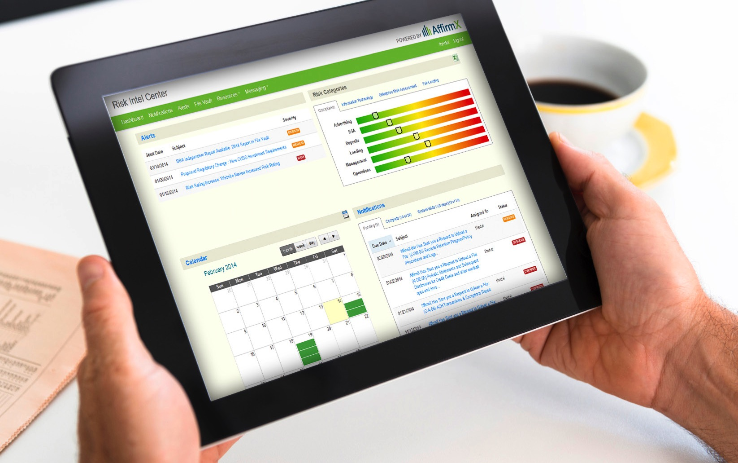
Seamless portability.
Log-in via any device, from your desktop computer to your tablet to your smart phone to keep up to date on everything compliance-related.

Slide 5
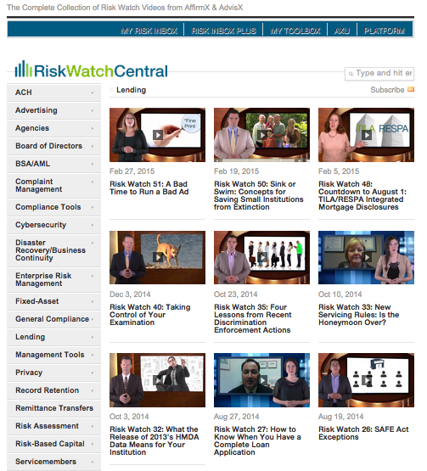
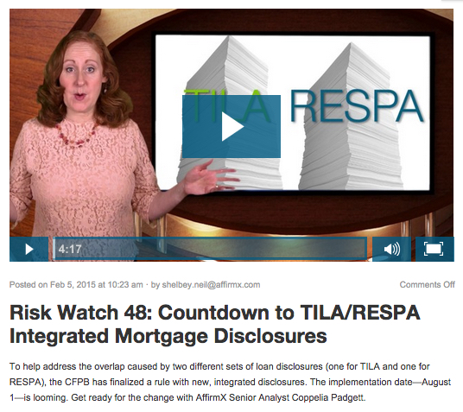
Educational videos.
Access to educational videos to guide your regulatory change management. In plain English, and typically in easy-to-swallow 3-5 minute chunks.

Slide 6
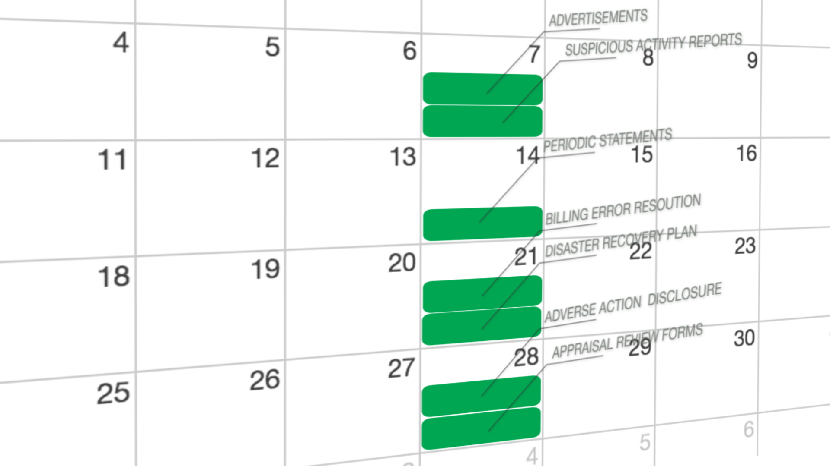
Distributes workload to lessen impact on resources.
Distributes your compliance reviews throughout the year. Allows you to easily customize your compliance review schedule to meet the needs of your financial institution.

Slide 7
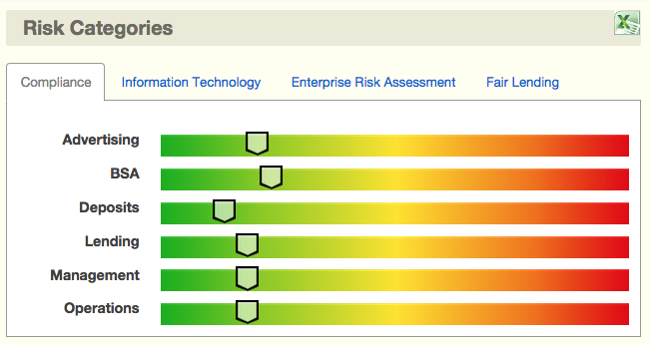
Risk scoring available.
Don’t guess what your risk is. See what our patented risk-based engine indicates.

Slide 8
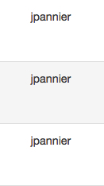
Keeps you on schedule.
Sends you notifications when it is time to review your next compliance artifact.

Slide 9
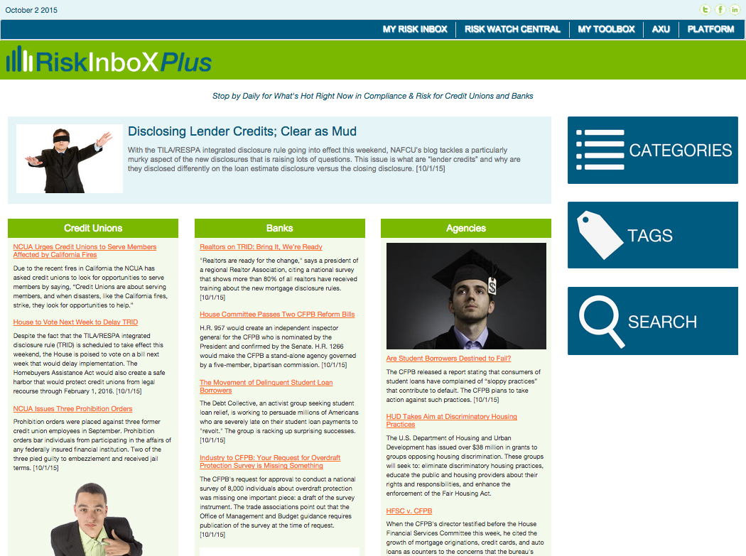
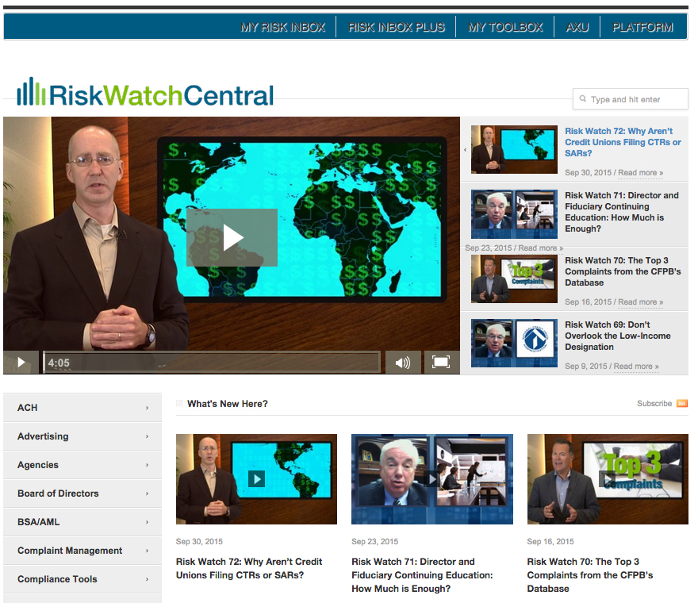
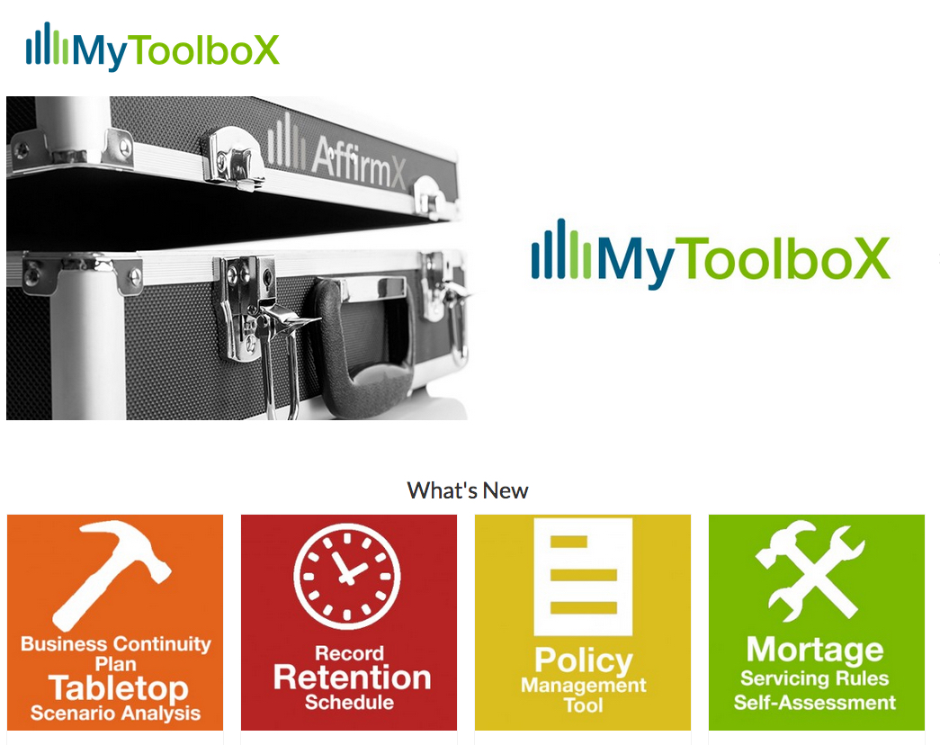
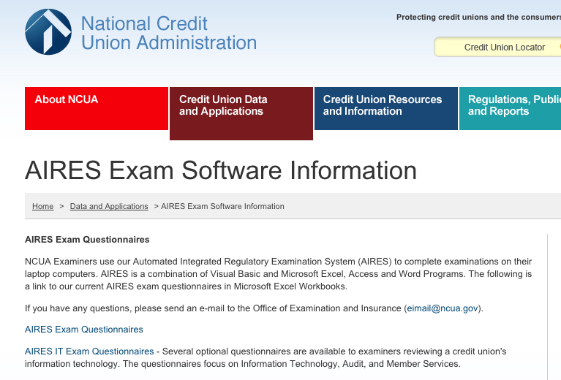
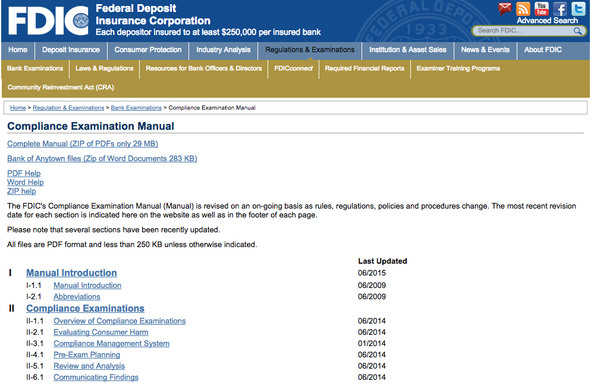
Your gateway.
Provides you with a list of available tools and resources to help you conduct each review

Slide 10
Help when you need it.
Upload an artifact anytime for review by our team of experts, for those times when you are slammed or for those areas that would benefit from outside review.

Slide 11
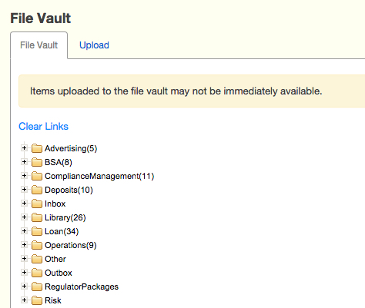
File vault.
What you upload to the secure file vault stays in the file vault. For safe-keeping, and to make sure it’s right where you need it when you need it.

Slide 12
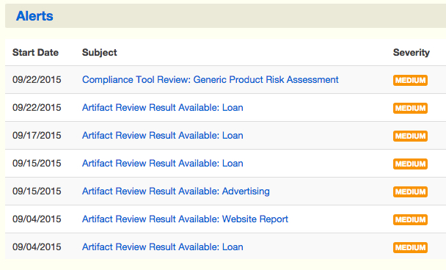
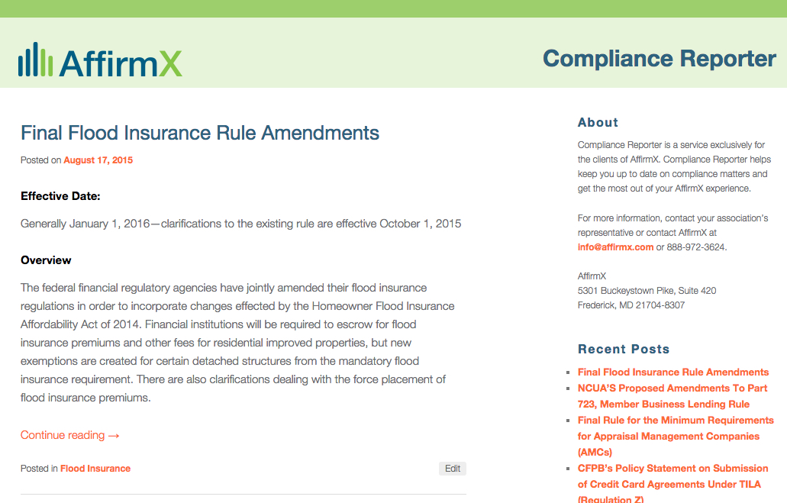
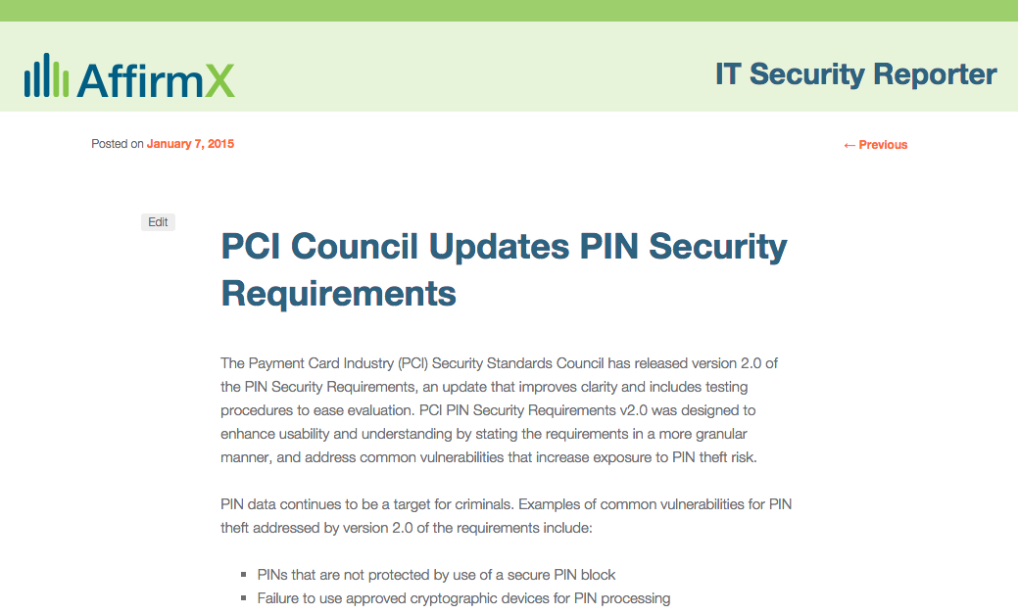
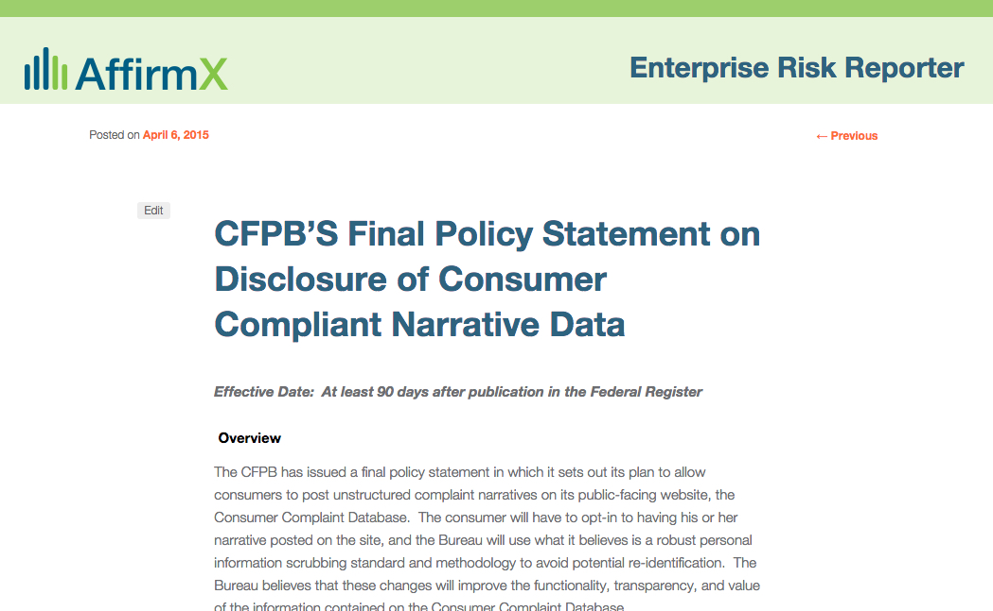
Know What’s Up.
Alerts keep you up to speed on new developments in regulatory compliance in plain English.

Slide 13
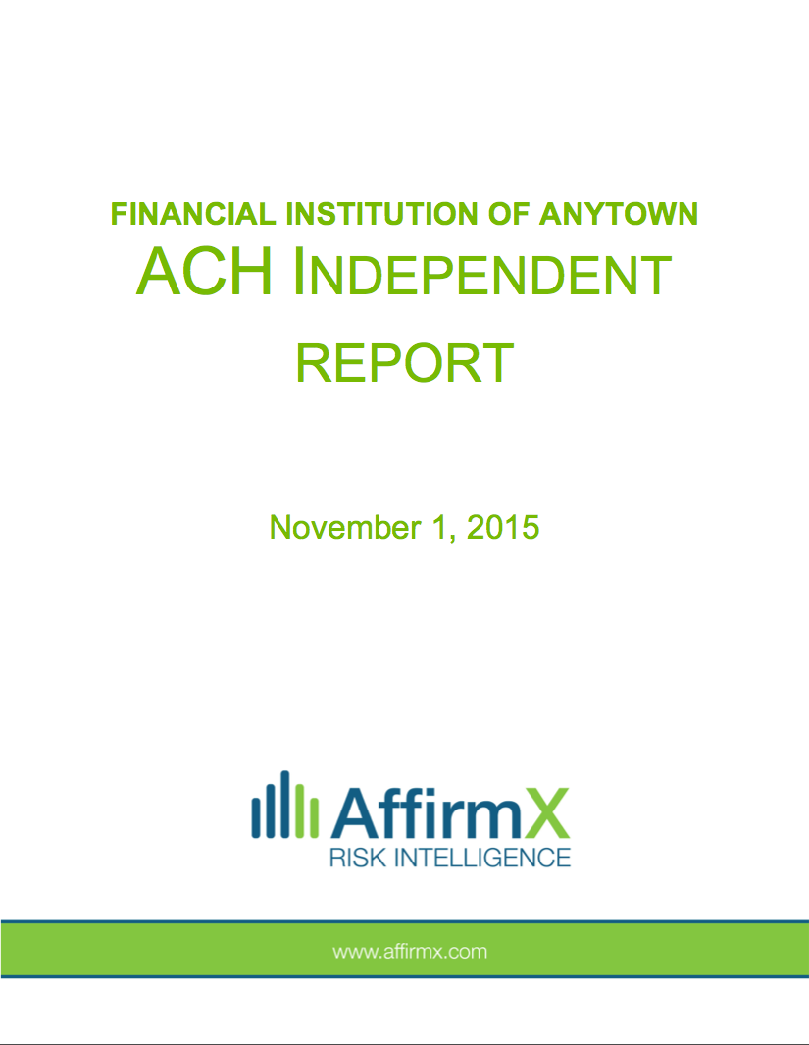
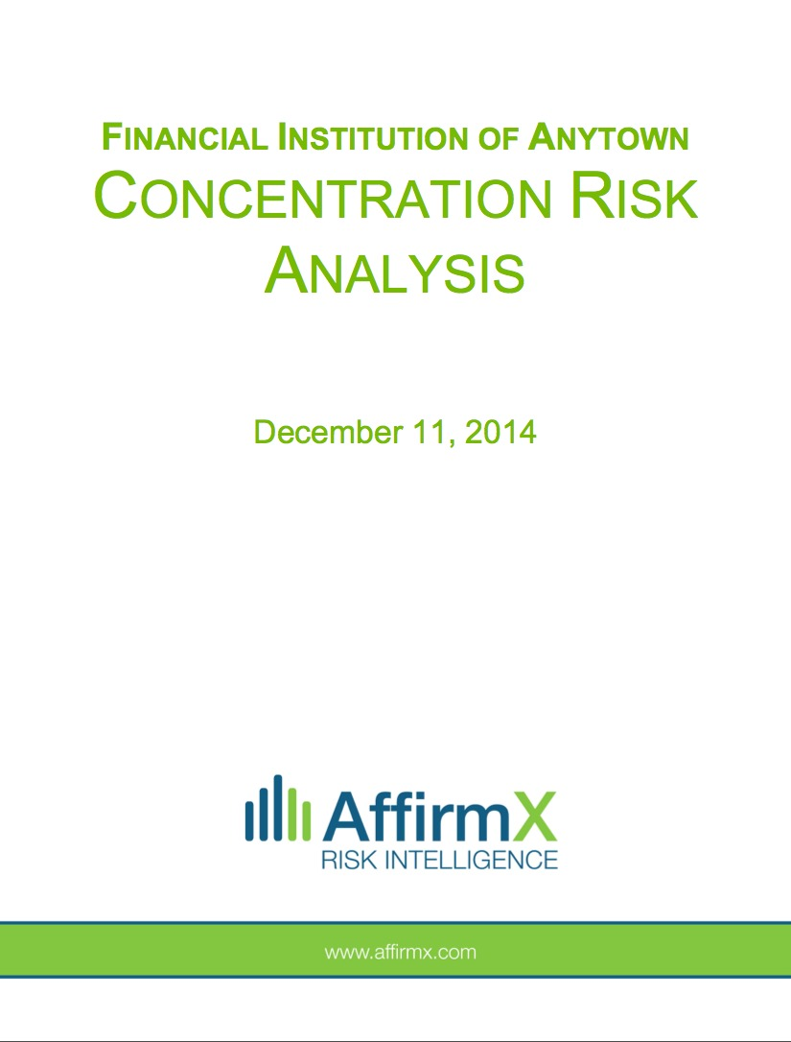
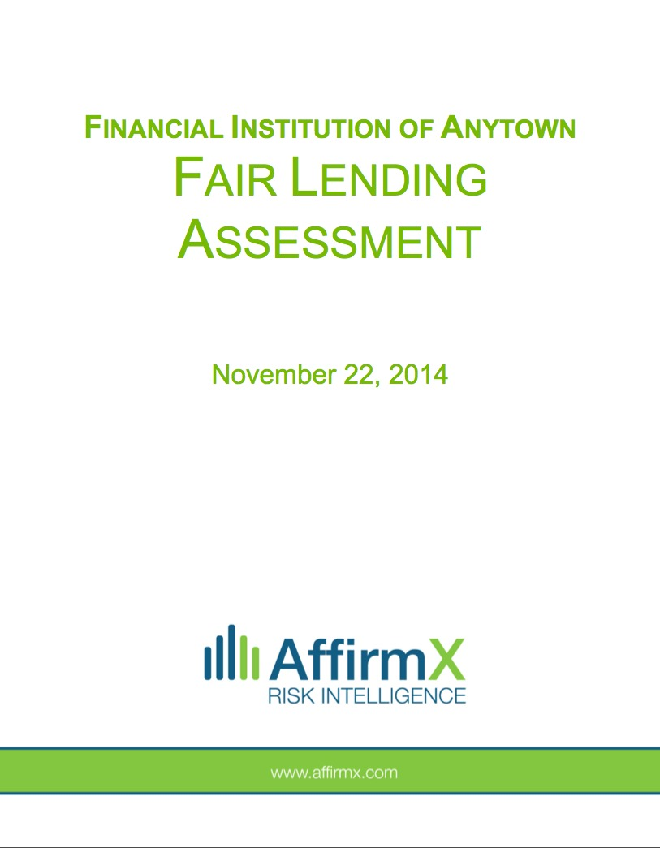
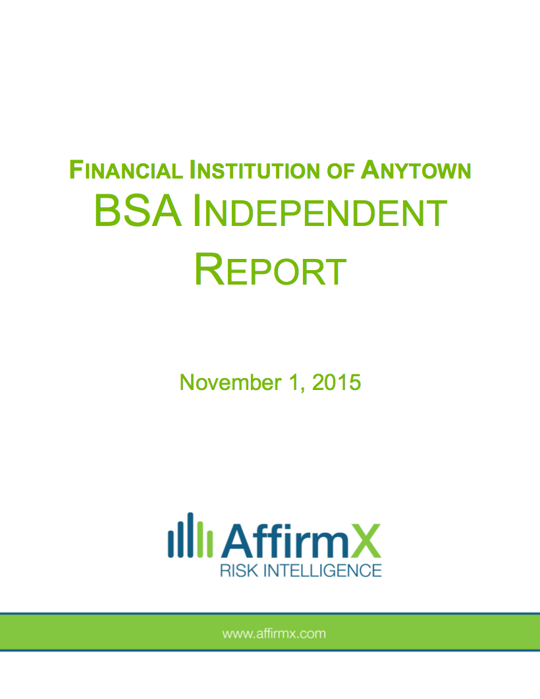
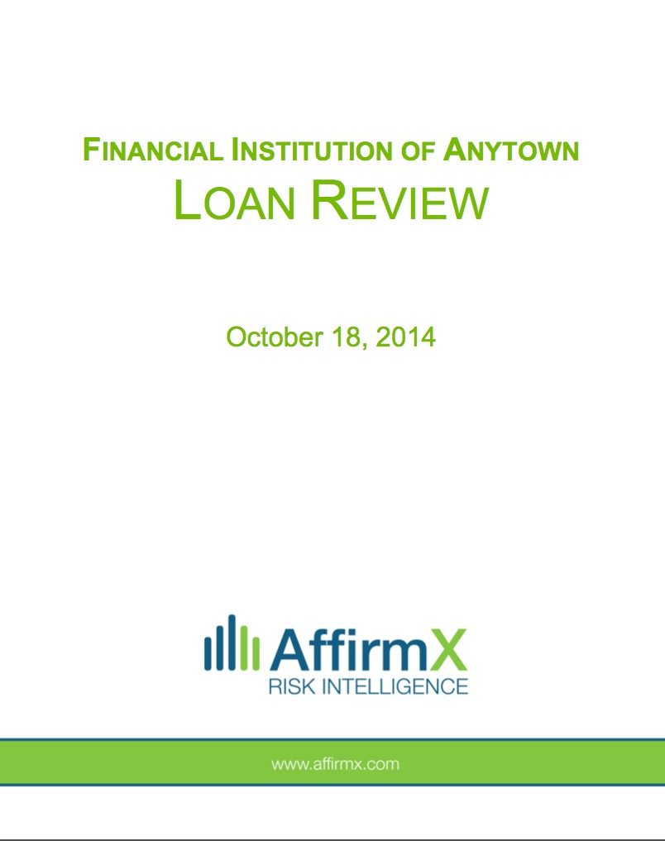
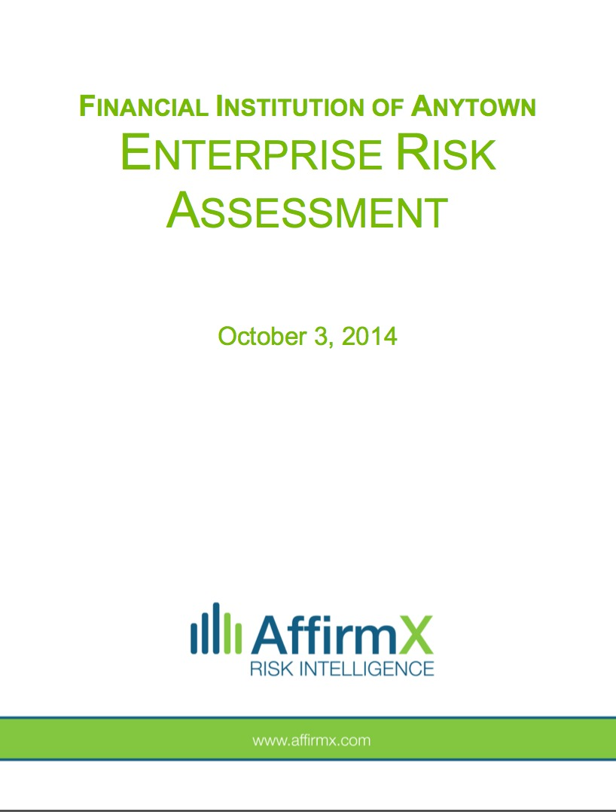
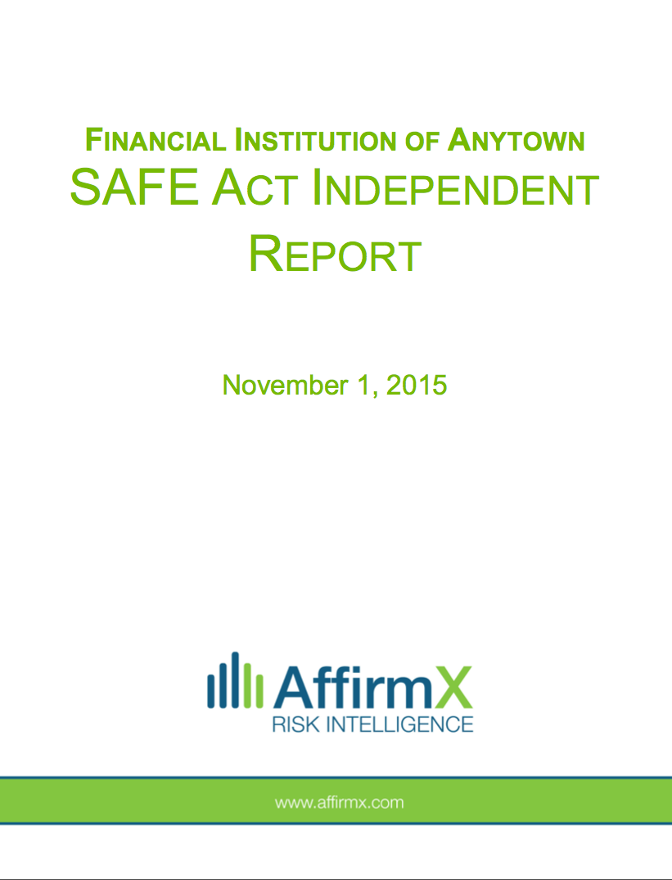
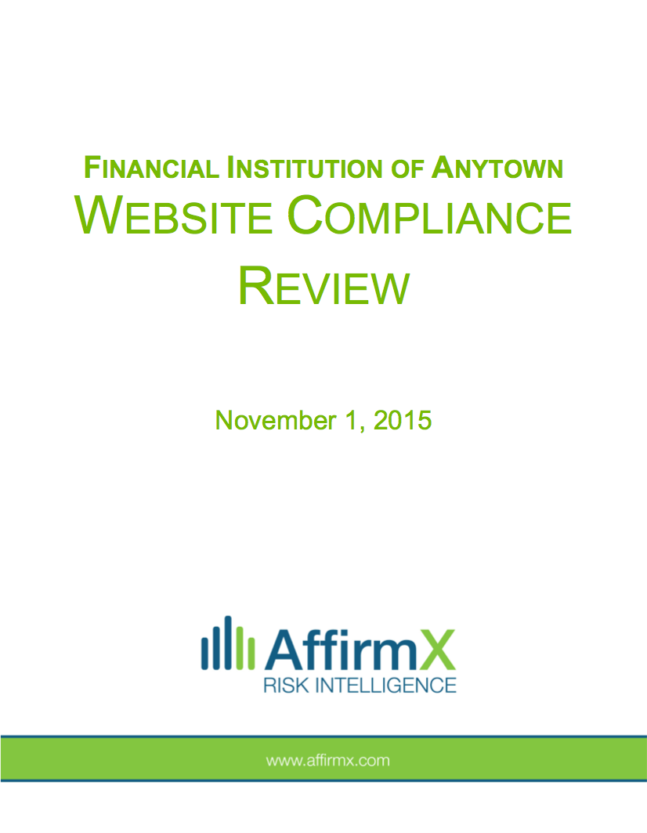
Access to other services right through the platform.
Reduced rates on those audits where independence is needed, such as the annual BSA audit, ACH audit, SAFE Act audit, website review, vendor management, IT management, policy management and more.
Access these services quickly and convenient right through the platform.
Vendor Management
IT Management
Policy Management

Slide 14
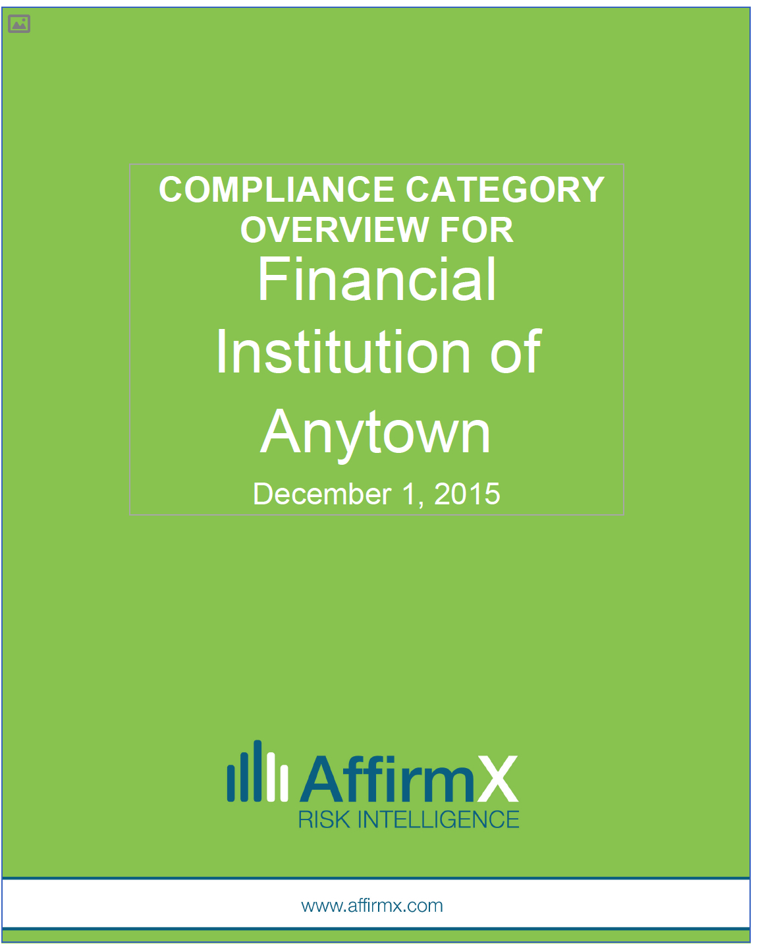
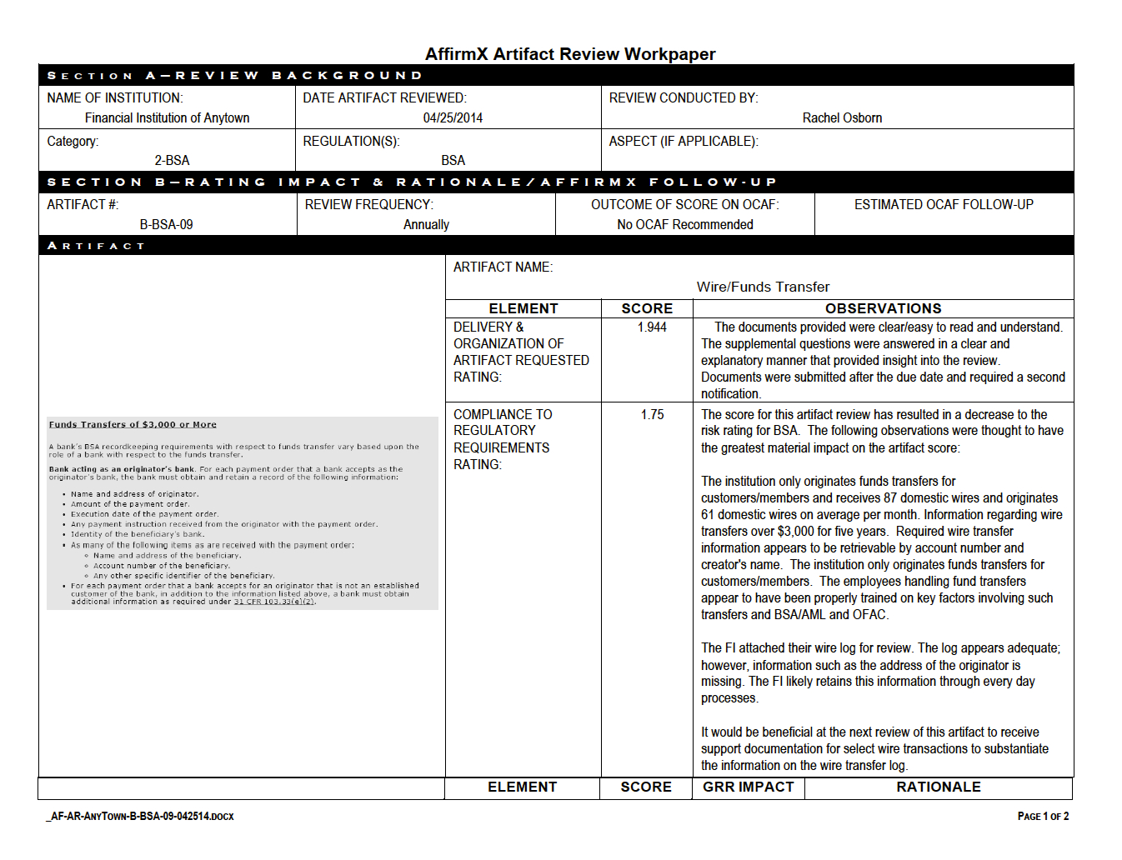
Report engine.
Generates a summary and workpapers for compliance committee meetings, board meetings, and regulatory examinations.

Slide 15
Learn more.
Contact us for asset-based pricing information on AffirmX Lite (in many cases, it’s free).
League contact person, email address, phone number
AffirmX, info@affirmx.com, 1-888-972-3624

